Slide 1
Applications of Finite Sets
Jeremy Knight
Final Oral Exam
Texas A&M University
March 29th 2012

Slide 2
Finite Fields and Cryptography
A field is a set that
is associative, commutative, and distributive for addition and multiplication,
contains an additive identity element (zero) and multiplicative identity element (unity),
contains an additive inverse for all elements, and
contains a multiplicative inverse for all non-zero elements.

Slide 3
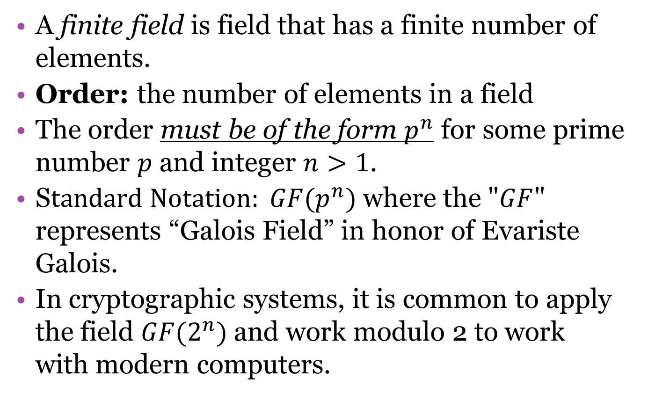
Basics of Finite Fields
A finite field is field that has a finite number of elements.
Order: the number of elements in a field
The order must be of the form $p^{n}$ for some prime number $p$ and integer $n>1$.
S$tandard Notation: GF(p^{n})$where the "$GF$" represents “Galois Field” in honor of Evariste Galois.
In cryptographic systems, it is common to apply the field $GF(2^{n})$and work modulo 2 to work with modern computers.

Slide 4

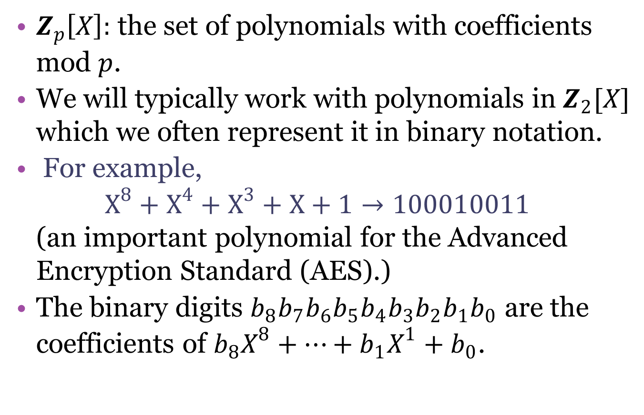
Constructing $GF(2^{m})$
$Z_{p}\left[X\right]:$ the set of polynomials with coefficients mod $p$.
We will typically work with polynomials in $Z_{2}[X]$ which we often represent it in binary notation.
For example,
$X^{8}+X^{4}+X^{3}+X+1→100010011$
(an important polynomial for the Advanced Encryption Standard (AES).)
The binary digits $b_{8}b_{7}b_{6}b_{5}b_{4}b_{3}b_{2}b_{1}b_{0}$ are the coefficients of $b_{8}X^{8}+…+b_{1}X^{1}+b_{0}$.

Slide 5

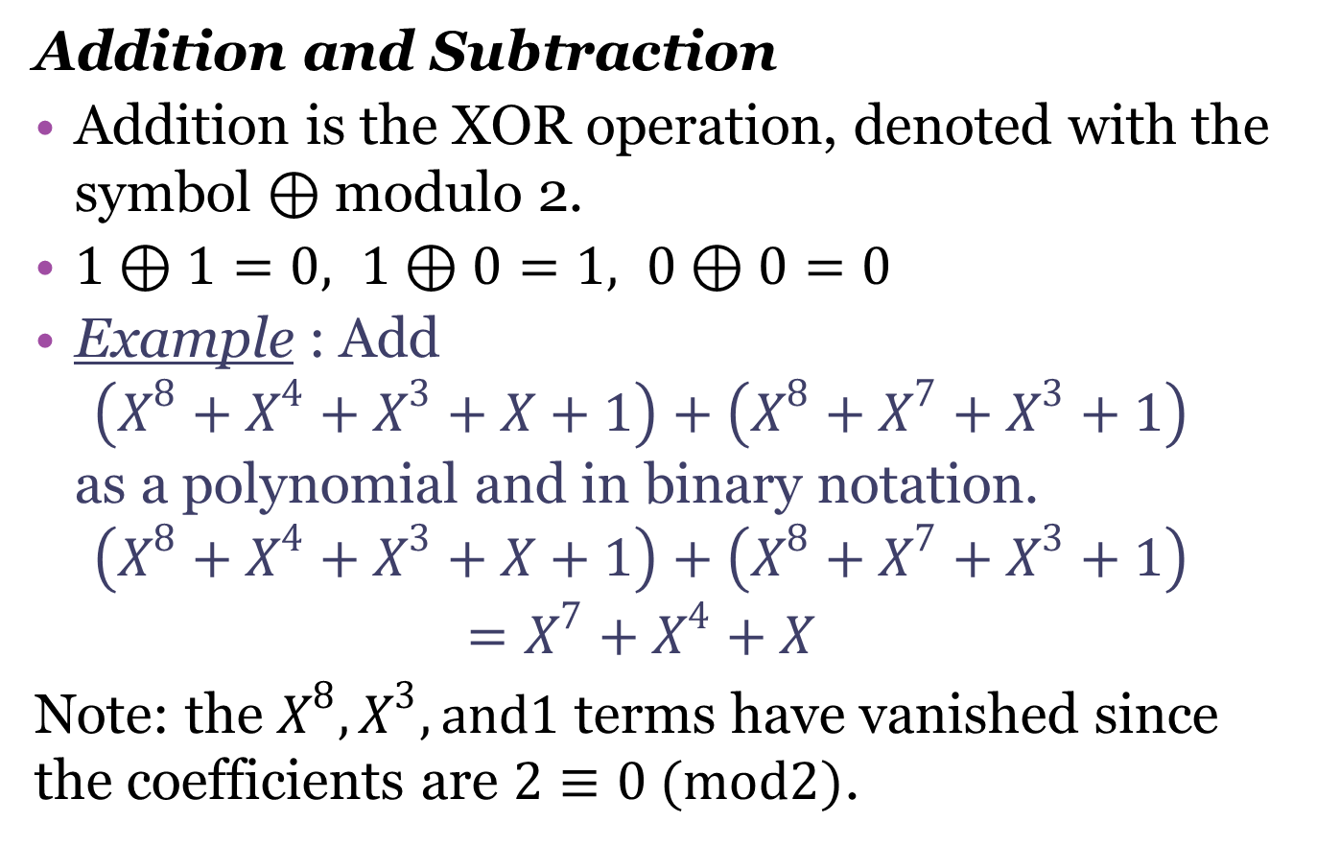
Arithmetic of $GF(2^{m})$
Addition and Subtraction
Addition is the XOR operation, denoted with the symbol $⊕$modulo 2.
$1⊕1=0, 1⊕0=1, 0⊕0=0$
Example : Add
$\left(X^{8}+X^{4}+X^{3}+X+1\right)+\left(X^{8}+X^{7}+X^{3}+1\right)$
as a polynomial and in binary notation.
$$\left(X^{8}+X^{4}+X^{3}+X+1\right)+\left(X^{8}+X^{7}+X^{3}+1\right)$$
$$=X^{7}+X^{4}+X$$
Note: the $X^{8},X^{3}, and1$ terms have vanished since the coefficients are $2≡0 (mod2)$.

Slide 6

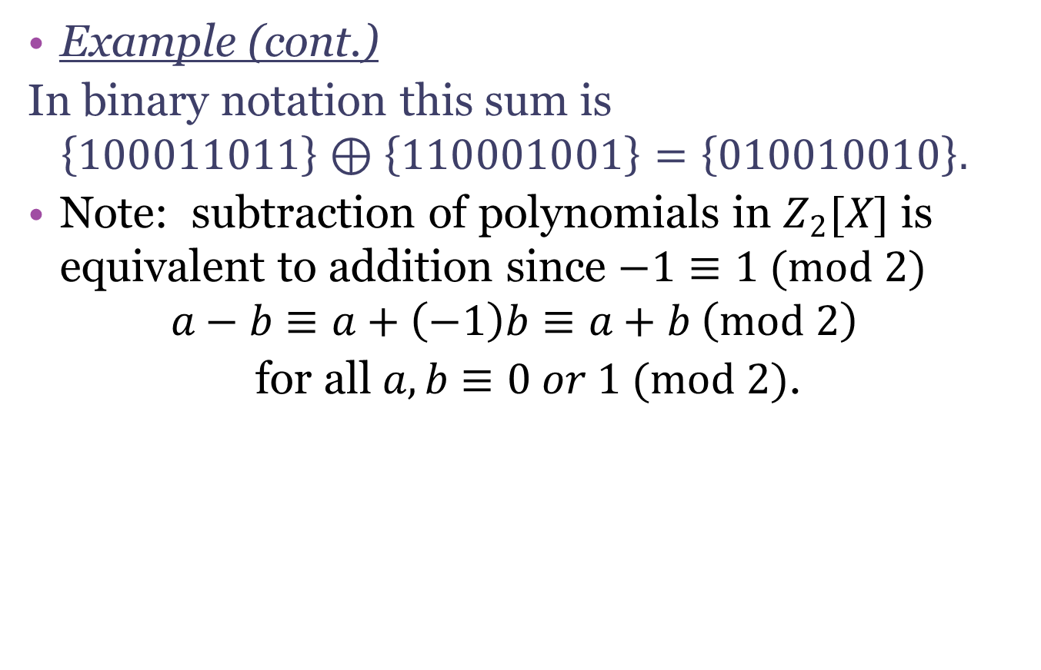
Arithmetic of $GF(2^{m})$
Example (cont.)
In binary notation this sum is
$$\left\{100011011\right\}⊕\left\{110001001\right\}=\left\{010010010\right\}.$$
Note: subtraction of polynomials in $Z_{2}[X]$ is equivalent to addition since $−1≡1 (mod 2)$
$$a−b≡a+\left(−1\right)b≡a+b \left(mod 2\right)$$
for all $a,b≡0 or 1 (mod 2)$.

Slide 7
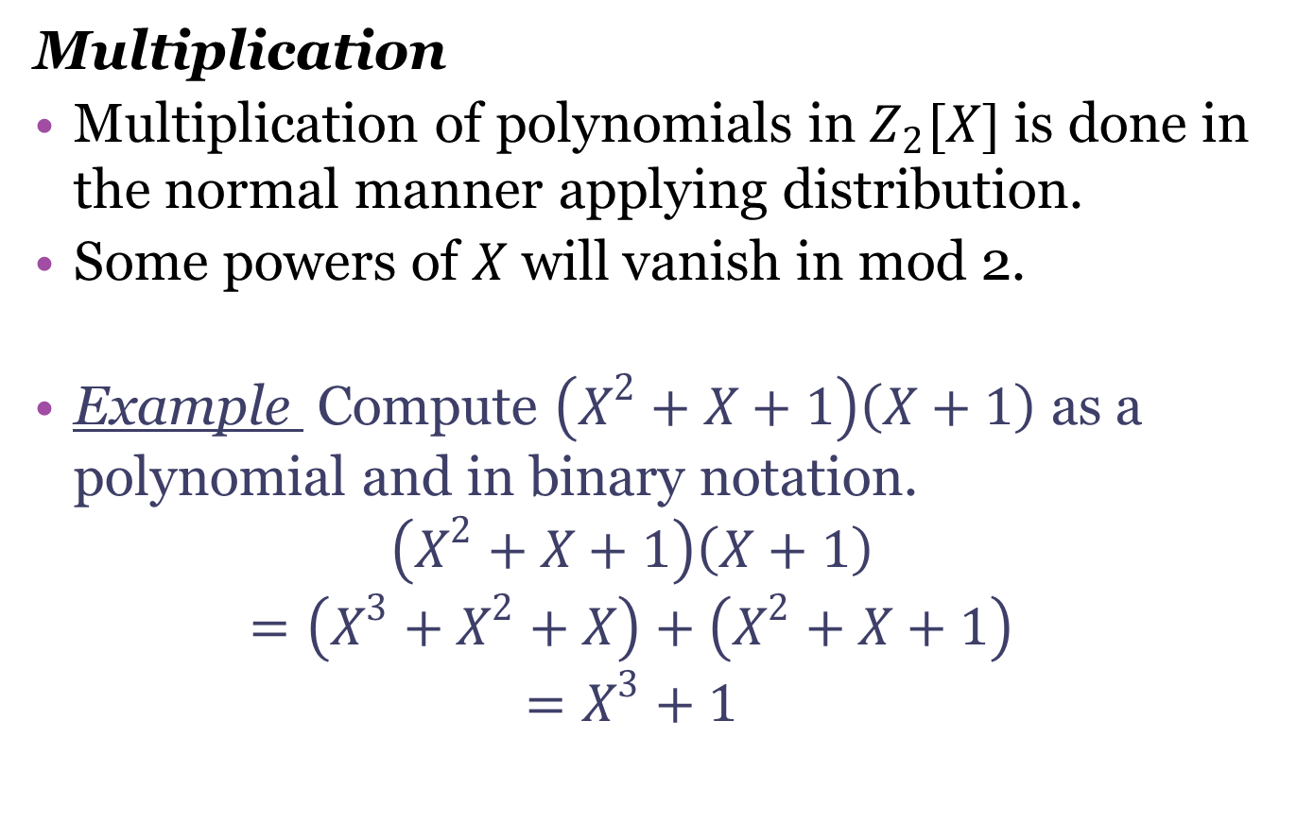
Arithmetic of $GF(2^{m})$
Multiplication
Multiplication of polynomials in $Z_{2}[X]$ is done in the normal manner applying distribution.
Some powers of $X$ will vanish in mod 2.
Example Compute $\left(X^{2}+X+1\right)\left(X+1\right)$ as a polynomial and in binary notation.
$$\left(X^{2}+X+1\right)\left(X+1\right)$$
$$=\left(X^{3}+X^{2}+X\right)+\left(X^{2}+X+1\right)$$
$$=X^{3}+1$$

Slide 8
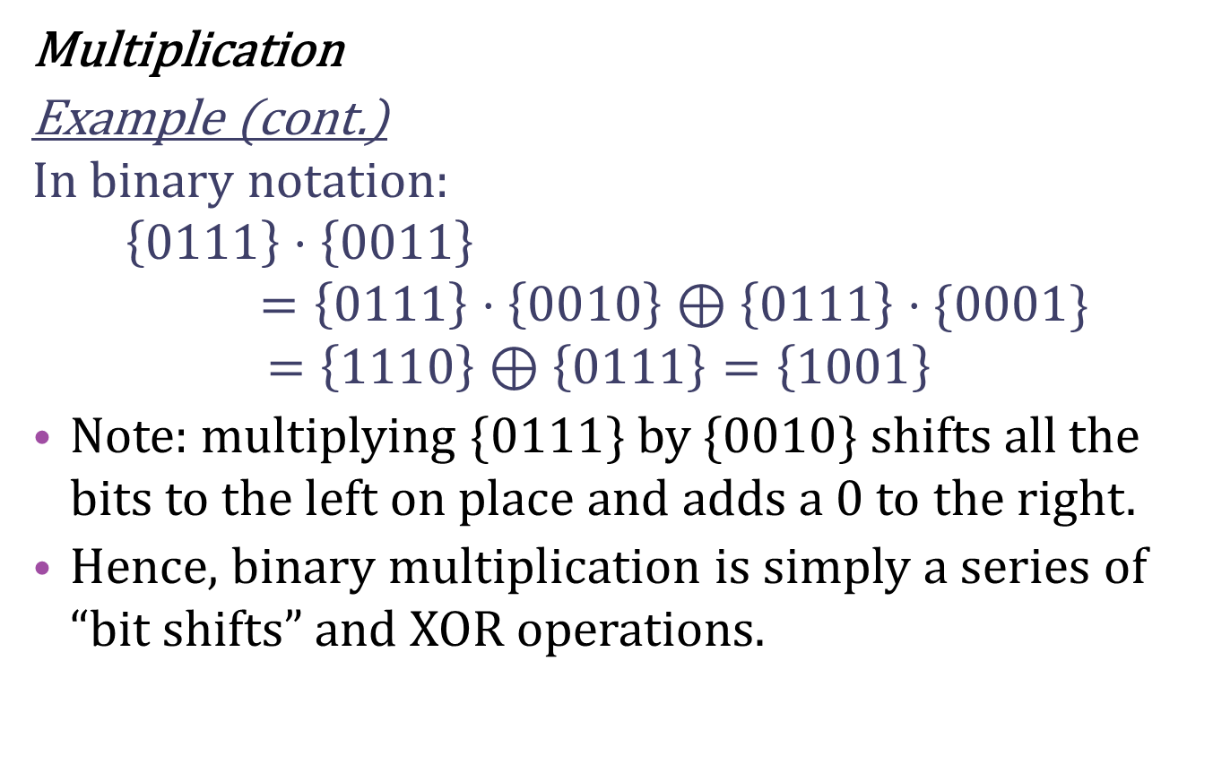
Arithmetic of $GF(2^{m})$
Multiplication
Example (cont.)
In binary notation:
$$\left\{0111\right\}⋅\left\{0011\right\}=\left\{0111\right\}⋅\left\{0010\right\}⊕\left\{0111\right\}⋅\{0001\}$$
$$=\left\{1110\right\}⊕\left\{0111\right\}=\left\{1001\right\}$$
Note: multiplying $\{0111\}$ by $\{0010\}$ shifts all the bits to the left on place and adds a 0 to the right.
Hence, binary multiplication is simply a series of “bit shifts” and XOR operations.

Slide 9
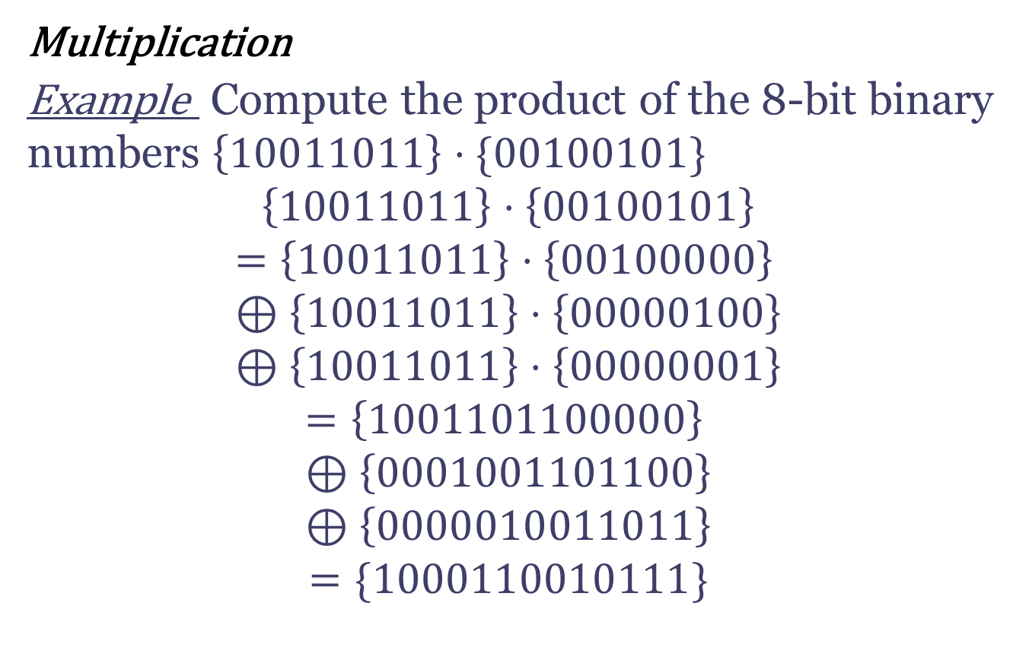
Arithmetic of $GF(2^{m})$
Multiplication
Example Compute the product of the 8-bit binary numbers $\left\{10011011\right\}⋅\{00100101\}$
$$\left\{10011011\right\}⋅\left\{00100101\right\}$$
$$=\left\{10011011\right\}⋅\left\{00100000\right\} \\ ⊕\left\{10011011\right\}⋅\left\{00000100\right\} \\ ⊕\left\{10011011\right\}⋅\left\{00000001\right\}$$
$$=\left\{1001101100000\right\} \\ ⊕\left\{0001001101100\right\} \\ ⊕\left\{0000010011011\right\}$$
$$=\{1000110010111\}$$

Slide 10
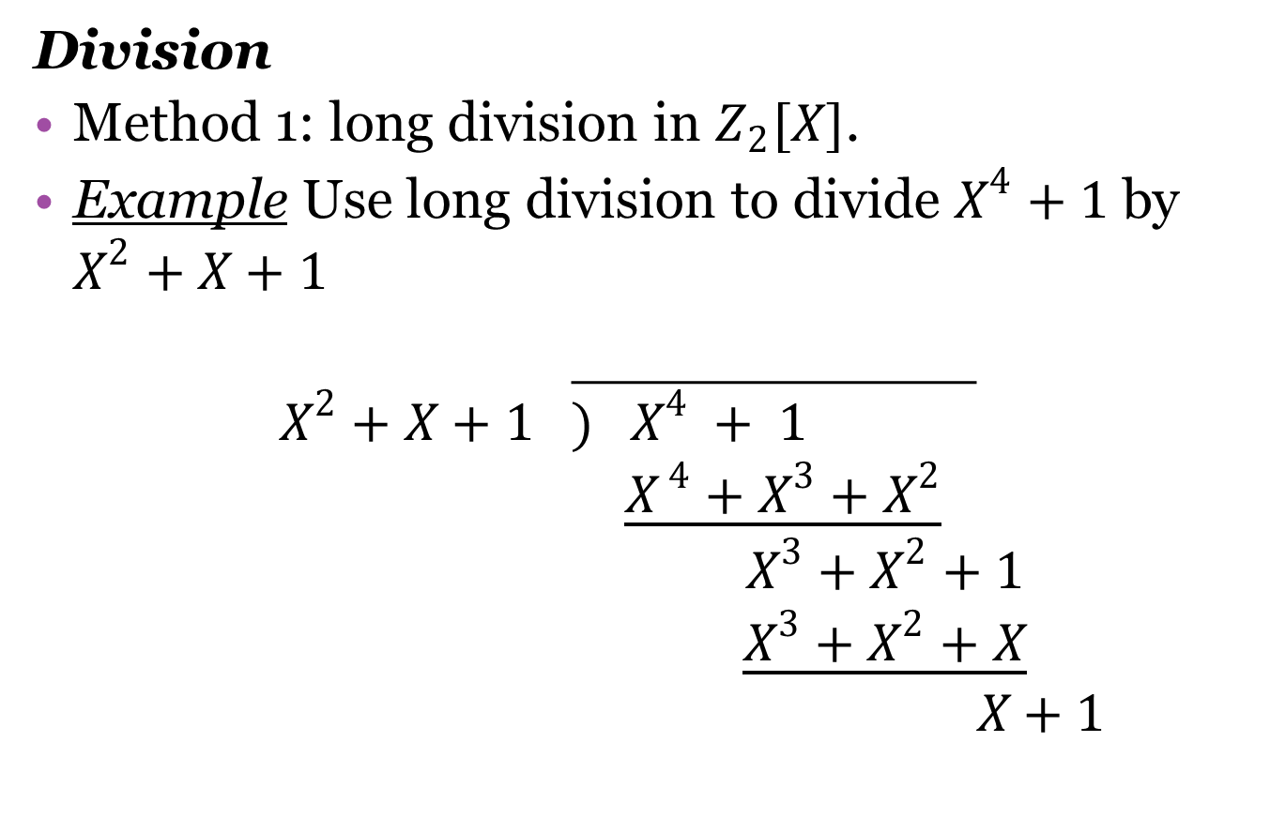



Arithmetic of $GF(2^{m})$
Division
Method 1: long division in $Z_{2}[X]$.
Example Use long division to divide $X^{4}+1$ by $X^{2}+X+1$
$$X^{2}+X+1 \overline{) X^{4} + 1 }$$
$$\underline{X^{ 4}+X^{3}+X^{2}}$$
$$X^{3}+X^{2}+1$$
$$\underline{X^{3}+X^{2}+X}$$
$$X+1$$
$${ X}^{2}$$
$$+X$$
$$r. X+1$$

Slide 11
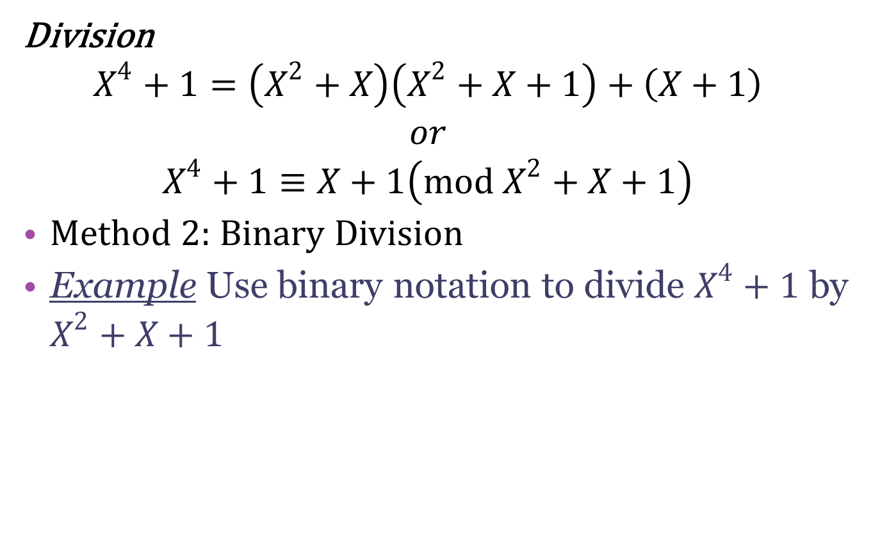
Arithmetic of $GF(2^{m})$
Division
$$X^{4}+1=\left(X^{2}+X\right)\left(X^{2}+X+1\right)+\left(X+1\right)$$
$$or \\ X^{4}+1≡X+1\left(mod X^{2}+X+1\right)$$
Method 2: Binary Division
Example Use binary notation to divide $X^{4}+1$ by $X^{2}+X+1$

Slide 12
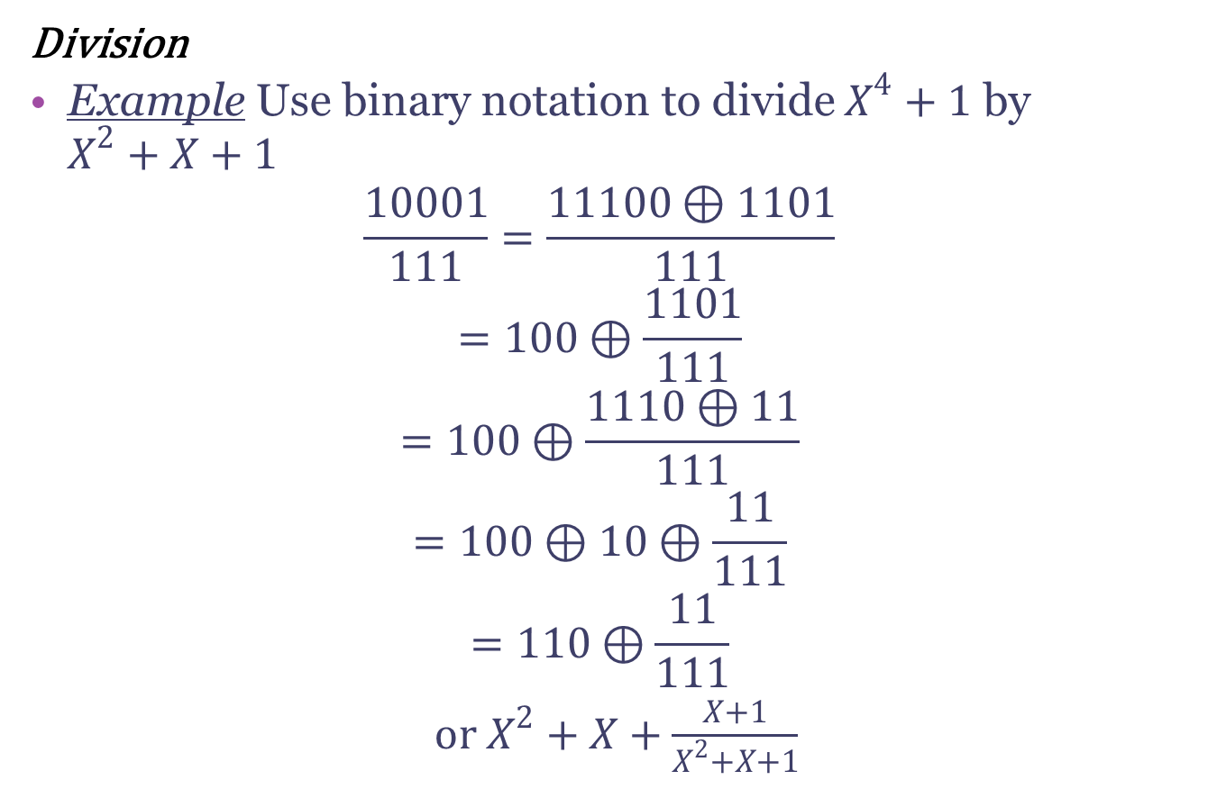
Arithmetic of $GF(2^{m})$
Division
Example Use binary notation to divide $X^{4}+1$ by $X^{2}+X+1$
$$\frac{10001}{111}=\frac{11100⊕1101}{111}$$
$$=100⊕\frac{1101}{111}$$
$$=100⊕\frac{1110⊕11}{111}$$
$$=100⊕10⊕\frac{11}{111}$$
$$=110⊕\frac{11}{111}$$
or $X^{2}+X+\frac{X+1}{X^{2}+X+1}$

Slide 13
Arithmetic of $GF(2^{m})$
MATLAB Algorithms.
binxor.m :
Binary addition is performed in one line in
c=dec2bin(bitxor(bin2dec(a),bin2dec(b)));
binmult.m:
Binary multiplication applying a bitshift and distribution.
bindiv.m:
Binary division
bin2poly.m:
Converts a binary number to a polynomial.

Slide 14
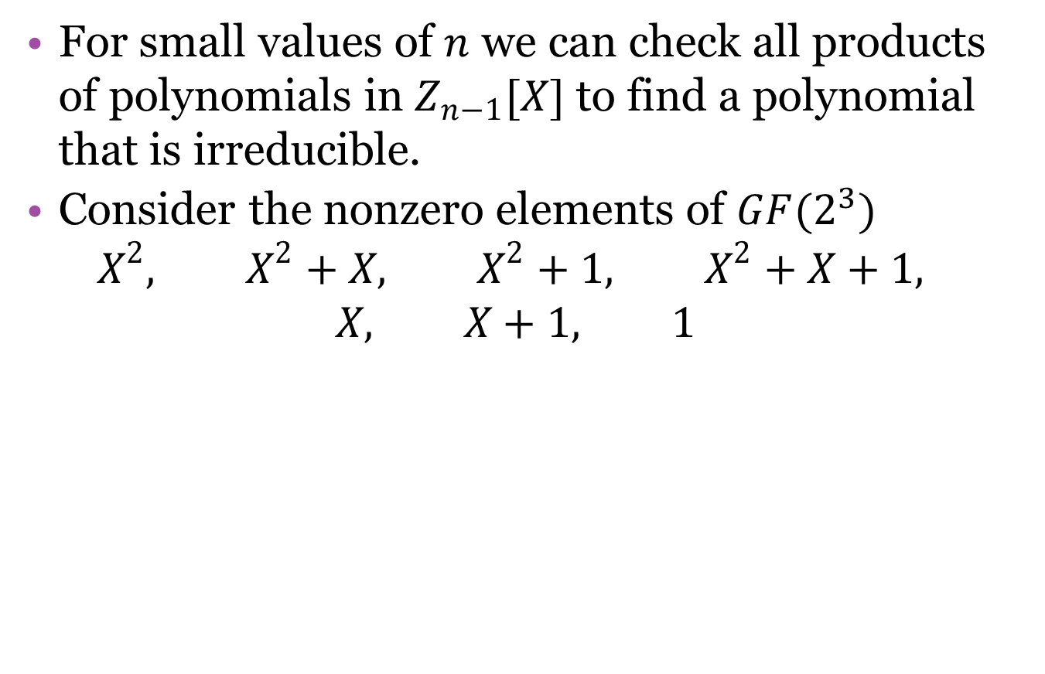
Irreducible Polynomials
For small values of $n$ we can check all products of polynomials in $Z_{n−1}[X]$ to find a polynomial that is irreducible.
Consider the nonzero elements of $GF(2^{3})$
$$X^{2}, X^{2}+X, X^{2}+1, X^{2}+X+1, \\ X, X+1, 1$$

Slide 15
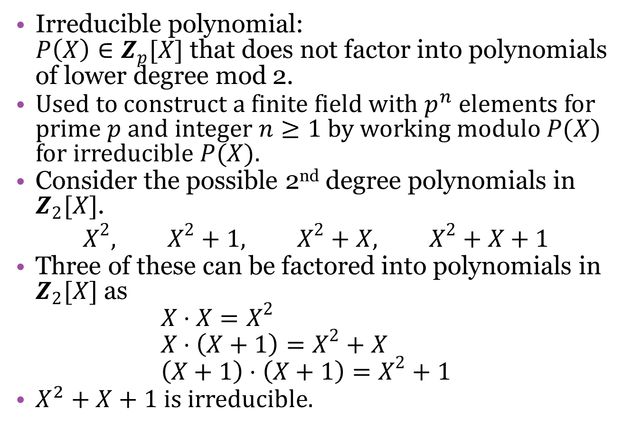
Irreducible Polynomials
Irreducible polynomial:
$P\left(X\right)∈Z_{p}[X]$ that does not factor into polynomials of lower degree mod 2.
Used to construct a finite field with $p^{n}$ elements for prime $p$ and integer $n≥1$ by working modulo $P(X)$ for irreducible $P(X)$.
Consider the possible 2nd degree polynomials in $Z_{2}[X]$.
$$X^{2}, X^{2}+1, X^{2}+X, X^{2}+X+1$$
Three of these can be factored into polynomials in $Z_{2}[X]$ as
$X⋅X=X^{2}$
$X⋅\left(X+1\right)=X^{2}+X$
$\left(X+1\right)⋅\left(X+1\right)=X^{2}+1$
$X^{2}+X+1$is irreducible.

Slide 16
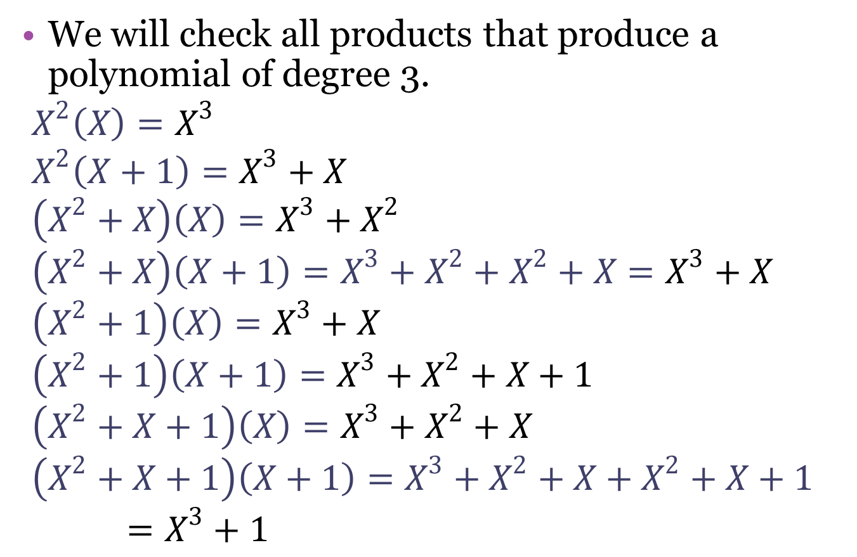
Irreducible Polynomials
We will check all products that produce a polynomial of degree 3.
$$X^{2}\left(X\right)=X^{3} \\ X^{2}\left(X+1\right)=X^{3}+X \\ \left(X^{2}+X\right)\left(X\right)=X^{3}+X^{2} \\ \left(X^{2}+X\right)\left(X+1\right)=X^{3}+X^{2}+X^{2}+X=X^{3}+X \\ \left(X^{2}+1\right)\left(X\right)=X^{3}+X \\ \left(X^{2}+1\right)\left(X+1\right)=X^{3}+X^{2}+X+1 \\ \left(X^{2}+X+1\right)\left(X\right)=X^{3}+X^{2}+X \\ \left(X^{2}+X+1\right)\left(X+1\right)=X^{3}+X^{2}+X+X^{2}+X+1=X^{3}+1$$

Slide 17
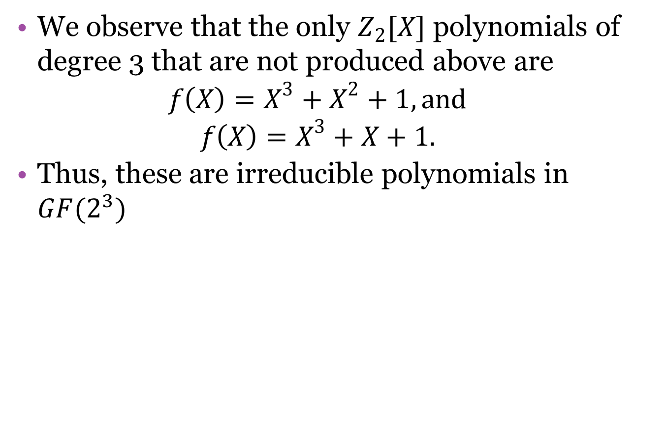
Irreducible Polynomials
We observe that the only $Z_{2}[X]$ polynomials of degree 3 that are not produced above are
$f\left(X\right)=X^{3}+X^{2}+1, and$
$f\left(X\right)=X^{3}+X+1.$
Thus, these are irreducible polynomials in $GF(2^{3})$

Slide 18
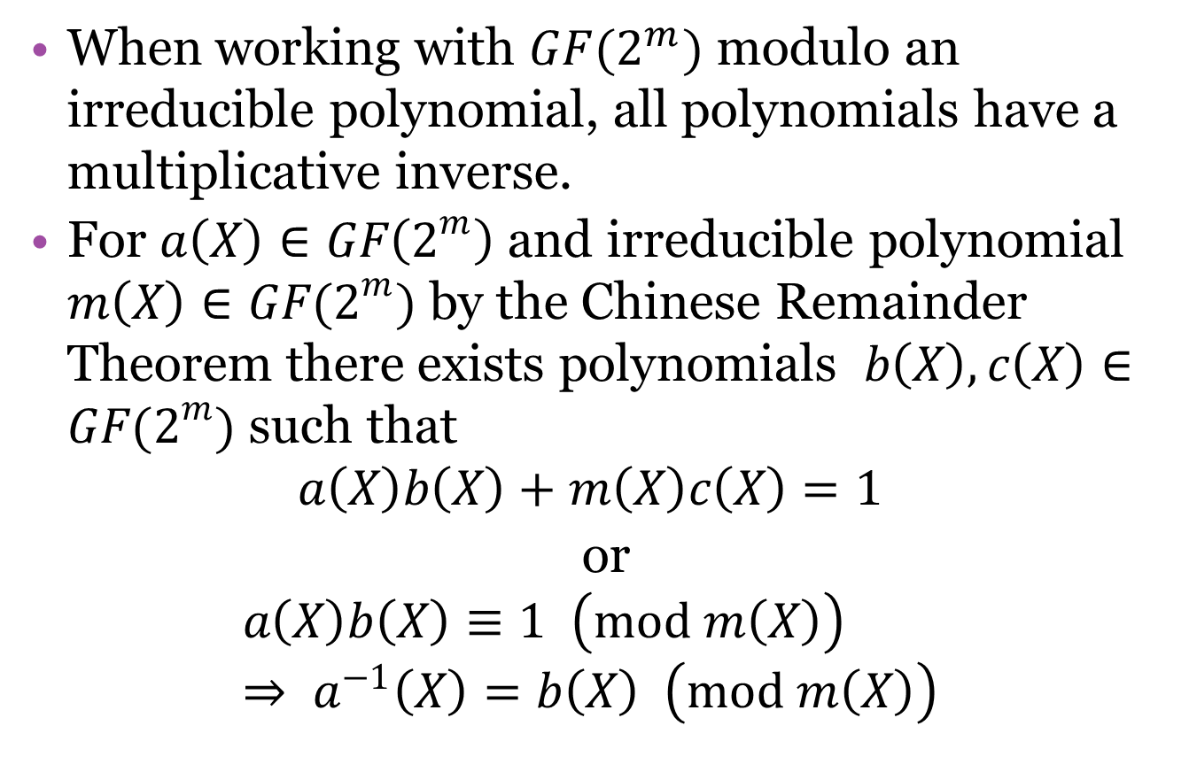
Multiplicative Inverse
When working with $GF(2^{m})$ modulo an irreducible polynomial, all polynomials have a multiplicative inverse.
For $a\left(X\right)∈GF\left(2^{m}\right)$ and irreducible polynomial $m\left(X\right)∈GF(2^{m})$ by the Chinese Remainder Theorem there exists polynomials $b\left(X\right),c\left(X\right)∈GF(2^{m})$ such that
$$a\left(X\right)b\left(X\right)+m\left(X\right)c\left(X\right)=1$$
or
$$a\left(X\right)b\left(X\right)≡1 \left(mod m\left(X\right)\right) \\ ⇒ a^{−1}\left(X\right)=b\left(X\right) \left(mod m\left(X\right)\right)$$

Slide 19
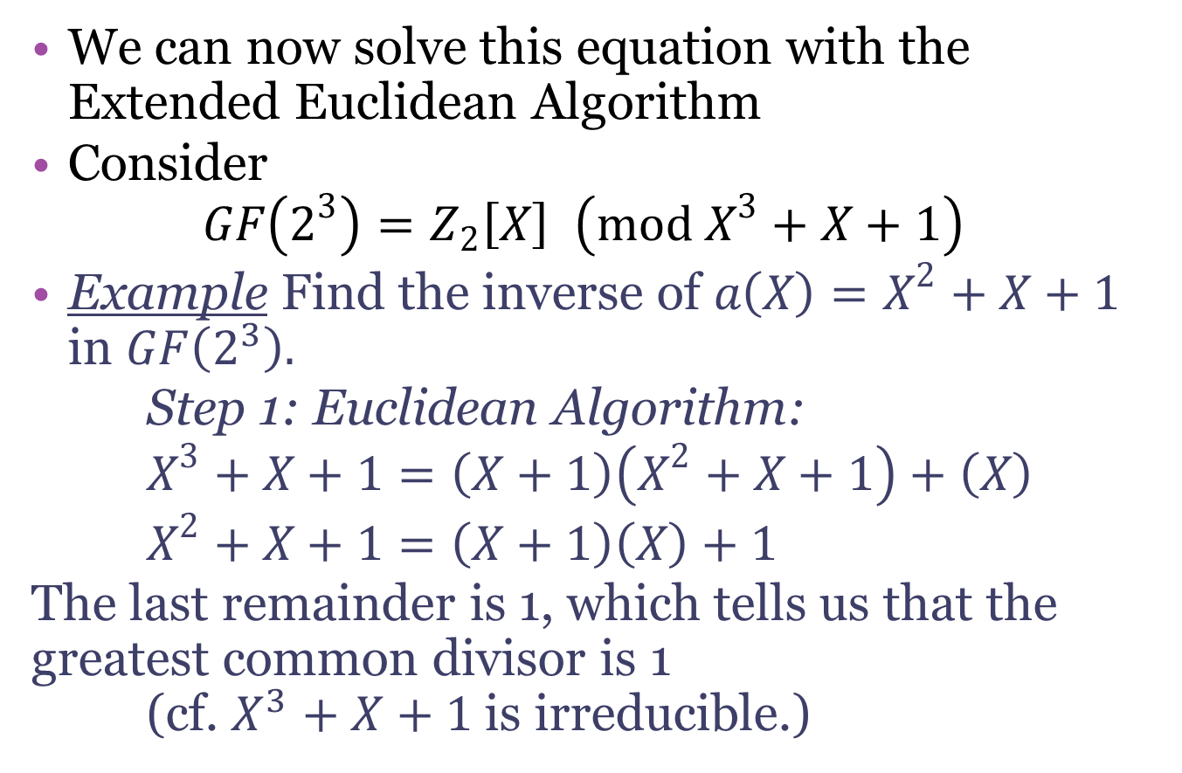
Multiplicative Inverse
We can now solve this equation with the Extended Euclidean Algorithm
Consider
$GF\left(2^{3}\right)=Z_{2}\left[X\right] \left(mod X^{3}+X+1\right)$
Example Find the inverse of $a\left(X\right)=X^{2}+X+1$ in $GF\left(2^{3}\right).$
Step 1: Euclidean Algorithm:
$X^{3}+X+1=\left(X+1\right)\left(X^{2}+X+1\right)+\left(X\right)$
$X^{2}+X+1=\left(X+1\right)\left(X\right)+1$
The last remainder is 1, which tells us that the greatest common divisor is 1
(cf. $X^{3}+X+1$is irreducible.)

Slide 20
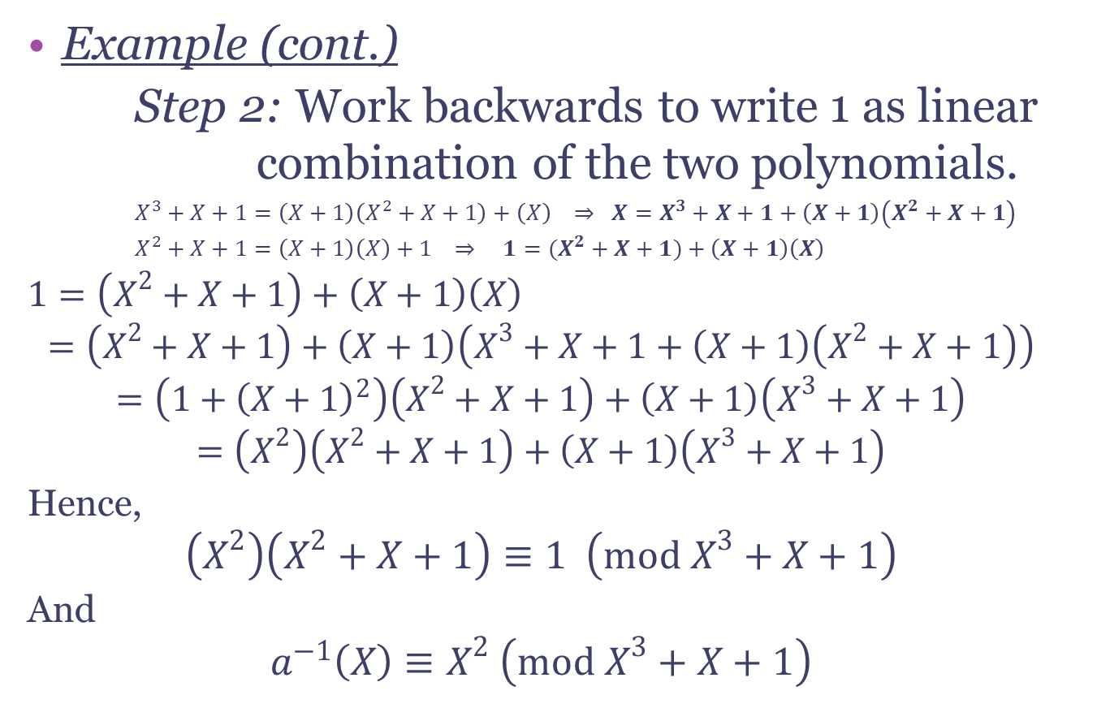
Multiplicative Inverse
Example (cont.)
Step 2: Work backwards to write 1 as linear combination of the two polynomials.
$X^{3}+X+1=\left(X+1\right)\left(X^{2}+X+1\right)+\left(X\right) ⇒ X=X^{3}+X+1+\left(X+1\right)\left(X^{2}+X+1\right)$
$X^{2}+X+1=\left(X+1\right)\left(X\right)+1 ⇒ 1=(X^{2}+X+1)+\left(X+1\right)\left(X\right)$
$1=\left(X^{2}+X+1\right)+\left(X+1\right)\left(X\right)$
$$=\left(X^{2}+X+1\right)+\left(X+1\right)\left(X^{3}+X+1+\left(X+1\right)\left(X^{2}+X+1\right)\right)$$
$$=\left(1+{\left(X+1\right)}^{2}\right)\left(X^{2}+X+1\right)+\left(X+1\right)\left(X^{3}+X+1\right)$$
$$=\left(X^{2}\right)\left(X^{2}+X+1\right)+\left(X+1\right)\left(X^{3}+X+1\right)$$
Hence,
$$\left(X^{2}\right)\left(X^{2}+X+1\right)≡1 \left(mod X^{3}+X+1\right)$$
And
$$a^{−1}\left(X\right)≡X^{2} \left(mod X^{3}+X+1\right)$$

Slide 21
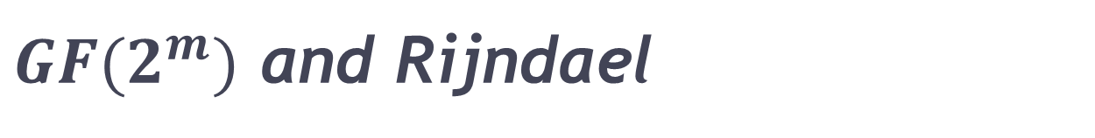
$GF(2^{m})$ and Rijndael
Basics of Rijndael (AES)
In 2002, the National Institute of Standards and Technology (NIST) adopted the Advanced Encryption Standard (AES) also known as Rijndael.
Currently the standard encryption algorithm that is designed to be used by Federal departments and agencies have information that requires encryption [NIST].
Algorithm accepts a 128 bit sequence of plaintext information and cycles through four layers to produce the ciphertext which is also a 128 bit sequence of data.

Slide 22
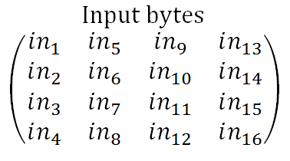
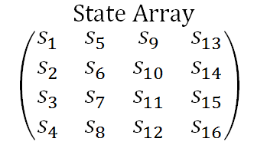
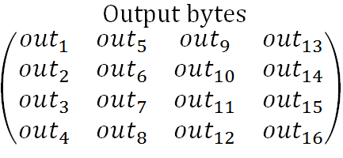
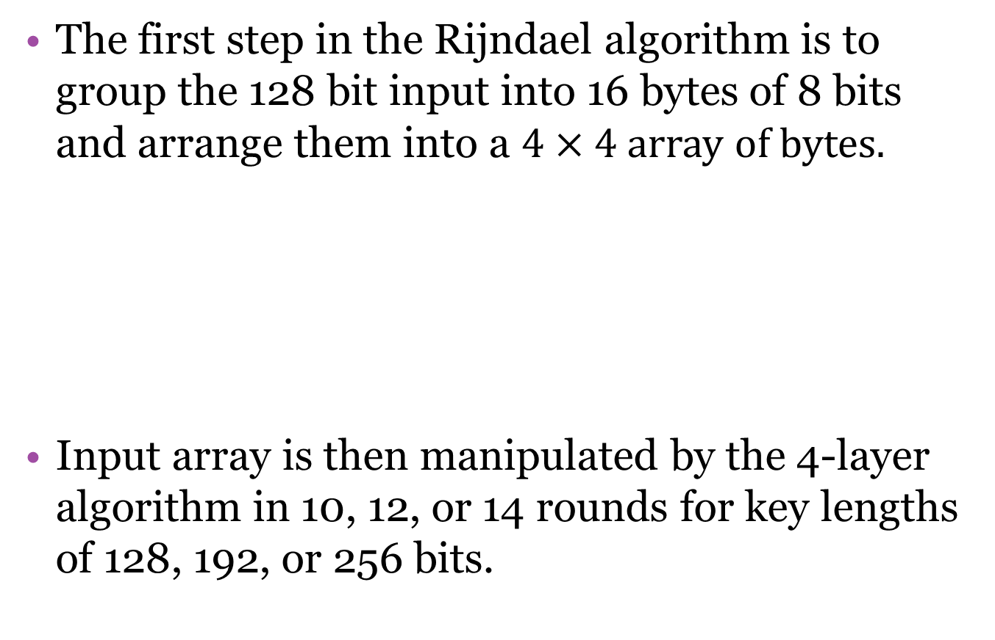
$GF(2^{m})$ and Rijndael
The first step in the Rijndael algorithm is to group the 128 bit input into 16 bytes of 8 bits and arrange them into a $4×4$ array of bytes.
Input array is then manipulated by the 4-layer algorithm in 10, 12, or 14 rounds for key lengths of 128, 192, or 256 bits.

Slide 23
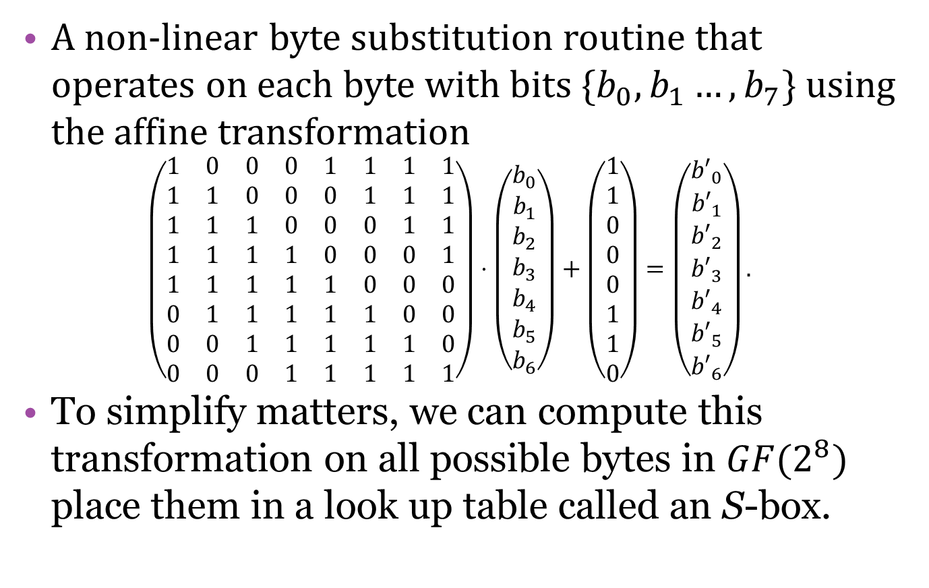
ByteSub (BS)
A non-linear byte substitution routine that operates on each byte with bits $\{b_{0},b_{1}…,b_{7}\}$ using the affine transformation
$$\left(\begin{matrix}1 & 0 & 0 & 0 & 1 & 1 & 1 & 1 \\ 1 & 1 & 0 & 0 & 0 & 1 & 1 & 1 \\ 1 & 1 & 1 & 0 & 0 & 0 & 1 & 1 \\ 1 & 1 & 1 & 1 & 0 & 0 & 0 & 1 \\ 1 & 1 & 1 & 1 & 1 & 0 & 0 & 0 \\ 0 & 1 & 1 & 1 & 1 & 1 & 0 & 0 \\ 0 & 0 & 1 & 1 & 1 & 1 & 1 & 0 \\ 0 & 0 & 0 & 1 & 1 & 1 & 1 & 1\end{matrix}\right)⋅\left(\begin{matrix}b_{0} \\ b_{1} \\ b_{2} \\ b_{3} \\ b_{4} \\ b_{5} \\ b_{6}\end{matrix}\right)+\left(\begin{matrix}1 \\ 1 \\ 0 \\ 0 \\ 0 \\ 1 \\ 1 \\ 0\end{matrix}\right)=\left(\begin{matrix}{b′}_{0} \\ {b′}_{1} \\ {b′}_{2} \\ {b′}_{3} \\ {b′}_{4} \\ {b′}_{5} \\ {b′}_{6}\end{matrix}\right).$$
To simplify matters, we can compute this transformation on all possible bytes in $GF(2^{8})$ place them in a look up table called an S-box.

Slide 24
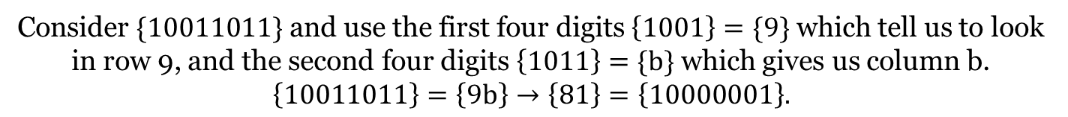
ByteSub (BS)
S-box in hexadecimal format [NIST]
S-Box Values
S(rs) |  | s
 |  | 0 | 1 | 2 | 3 | 4 | 5 | 6 | 7 | 8 | 9 | a | b | c | d | e | f
R | 0 | 63 | 7c | 77 | 7b | f2 | 6b | 6f | c5 | 30 | 01 | 67 | 2b | fe | d7 | ab | 76
 | 1 | ca | 82 | c9 | 7d | fa | 59 | 47 | f0 | ad | d4 | a2 | af | 9c | a4 | 72 | c0
 | 2 | b7 | fd | 93 | 26 | 36 | 3f | f7 | cc | 34 | a5 | e5 | f1 | 71 | d8 | 31 | 15
 | 3 | 04 | c7 | 23 | c3 | 18 | 96 | 05 | 9a | 07 | 12 | 80 | e2 | eb | 27 | b2 | 75
 | 4 | 09 | 83 | 2c | 1a | 1b | 6e | 5a | a0 | 52 | 3b | d6 | b3 | 29 | e3 | 2f | 84
 | 5 | 53 | d1 | 00 | ed | 20 | fc | b1 | 5b | 6a | cb | be | 39 | 4a | 4c | 58 | cf
 | 6 | d0 | ef | aa | fb | 43 | 4d | 33 | 85 | 45 | f9 | 02 | 7f | 50 | 3c | 9f | a8
 | 7 | 51 | a3 | 40 | 8f | 92 | 9d | 38 | f5 | bc | b6 | da | 21 | 10 | ff | f3 | d2
 | 8 | cd | 0c | 13 | ec | 5f | 97 | 44 | 17 | c4 | a7 | 7e | 3d | 64 | 5d | 19 | 73
 | 9 | 60 | 81 | 4f | dc | 22 | 2a | 90 | 88 | 46 | ee | b8 | 14 | de | 5e | 0b | db
 | a | e0 | 32 | 3a | 0a | 49 | 06 | 24 | 5c | c2 | d3 | ac | 62 | 91 | 95 | e4 | 79
 | b | e7 | c8 | 37 | 6d | 8d | d5 | 4e | a9 | 6c | 56 | f4 | ea | 65 | 7a | ae | 08
 | c | ba | 78 | 25 | 2e | 1c | a6 | b4 | c6 | e8 | dd | 74 | 1f | 4b | bd | 8b | 8a
 | d | 70 | 3e | b5 | 66 | 48 | 03 | f6 | 0e | 61 | 35 | 57 | b9 | 86 | c1 | 1d | 9e
 | e | e1 | f8 | 98 | 11 | 69 | d9 | 8e | 94 | 9b | 1e | 87 | e9 | ce | 55 | 28 | df
 | f | 8c | a1 | 89 | 0d | bf | e6 | 42 | 68 | 41 | 99 | 2d | 0f | b0 | 54 | bb | 16
Consider $\{10011011\}$ and use the first four digits $\left\{1001\right\}=\{9\}$ which tell us to look in row 9, and the second four digits $\left\{1011\right\}=\{b\}$ which gives us column b.
$$\left\{10011011\right\}=\left\{9b\right\}→\left\{81\right\}=\left\{10000001\right\}.$$

Slide 25
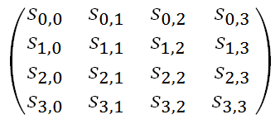
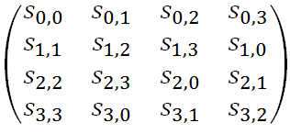
ShiftRow (SR)
The ShiftRow (SR) layer offsets the bytes cyclically by 0, 1, 2, and 3 columns in rows 1, 2, 3, and 4 respectively.

Slide 26
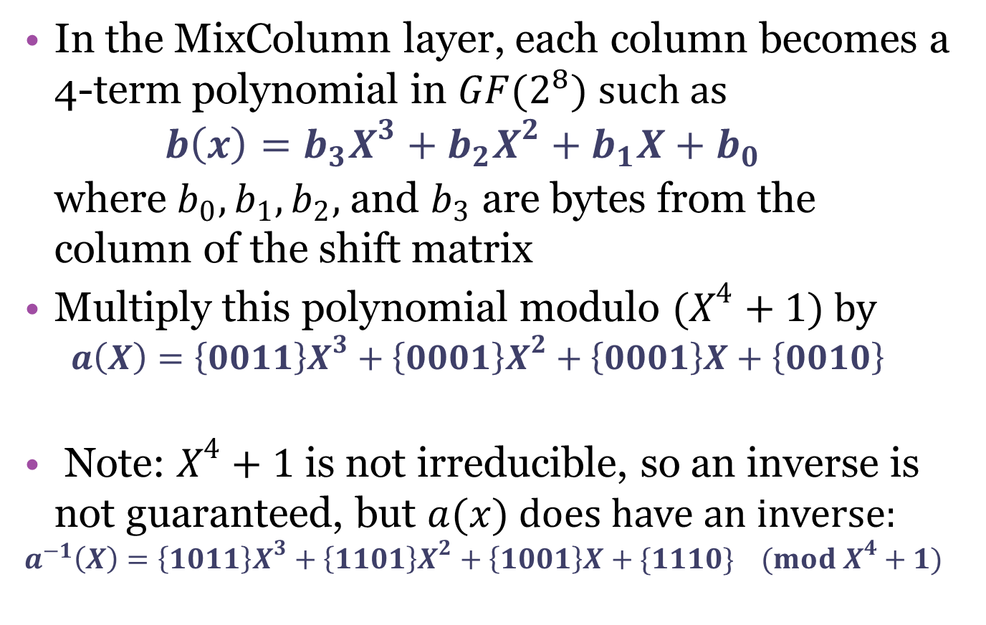
MixColumns (MC)
In the MixColumn layer, each column becomes a 4-term polynomial in $GF(2^{8})$ such as
$b\left(x\right)=b_{3}X^{3}+b_{2}X^{2}+b_{1}X+b_{0}$
where $b_{0},b_{1}, b_{2},$ and $b_{3}$ are bytes from the
column of the shift matrix
Multiply this polynomial modulo $(X^{4}+1)$ by
$a\left(X\right)=\left\{0011\right\}X^{3}+\left\{0001\right\}X^{2}+\left\{0001\right\}X+\left\{0010\right\}$
Note: $X^{4}+1$ is not irreducible, so an inverse is not guaranteed, but $a(x)$ does have an inverse:
$$a^{−1}\left(X\right)=\left\{1011\right\}X^{3}+\left\{1101\right\}X^{2}+\left\{1001\right\}X+\{1110\} (mod X^{4}+1)$$

Slide 27
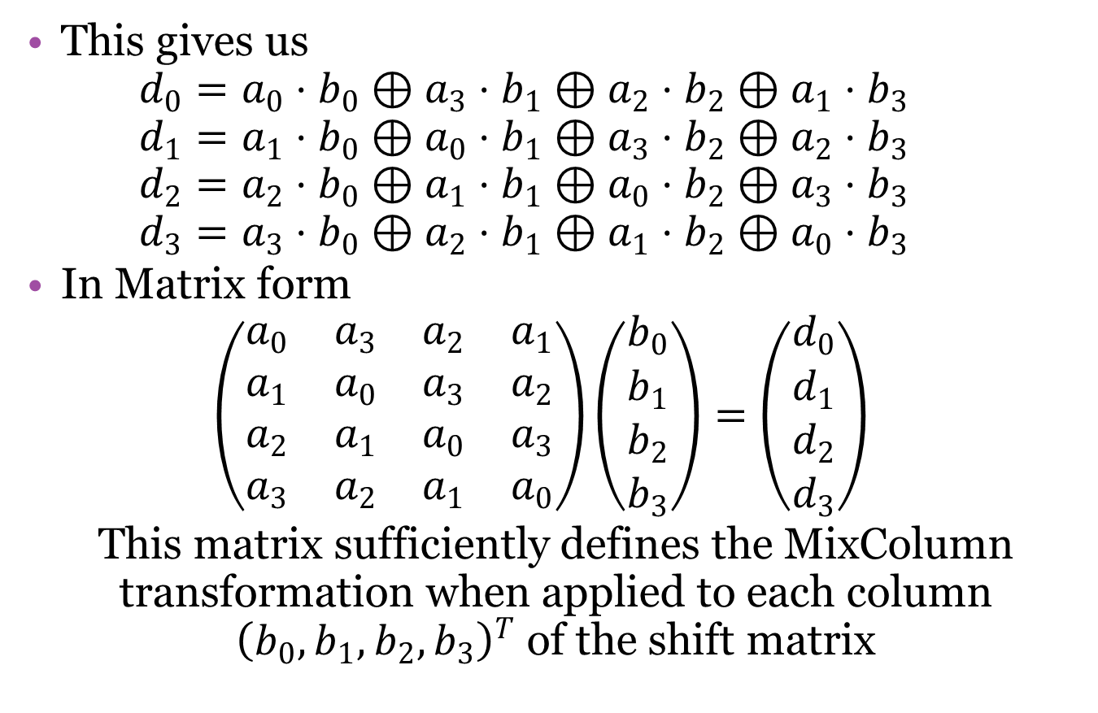
MixColumns (MC)
This gives us
$d_{0}=a_{0}⋅b_{0}⊕a_{3}⋅b_{1}⊕a_{2}⋅b_{2}⊕a_{1}⋅b_{3}$
$d_{1}=a_{1}⋅b_{0}⊕a_{0}⋅b_{1}⊕a_{3}⋅b_{2}⊕a_{2}⋅b_{3}$
$d_{2}=a_{2}⋅b_{0}⊕a_{1}⋅b_{1}⊕a_{0}⋅b_{2}⊕a_{3}⋅b_{3}$
$d_{3}=a_{3}⋅b_{0}⊕a_{2}⋅b_{1}⊕a_{1}⋅b_{2}⊕a_{0}⋅b_{3}$
In Matrix form
$$\left(\begin{matrix}a_{0} & a_{3} & a_{2} & a_{1} \\ a_{1} & a_{0} & a_{3} & a_{2} \\ a_{2} & a_{1} & a_{0} & a_{3} \\ a_{3} & a_{2} & a_{1} & a_{0}\end{matrix}\right)\left(\begin{matrix}b_{0} \\ b_{1} \\ b_{2} \\ b_{3}\end{matrix}\right)=\left(\begin{matrix}d_{0} \\ d_{1} \\ d_{2} \\ d_{3}\end{matrix}\right)$$
This matrix sufficiently defines the MixColumn transformation when applied to each column ${\left(b_{0},b_{1},b_{2},b_{3}\right)}^{T}$ of the shift matrix

Slide 28
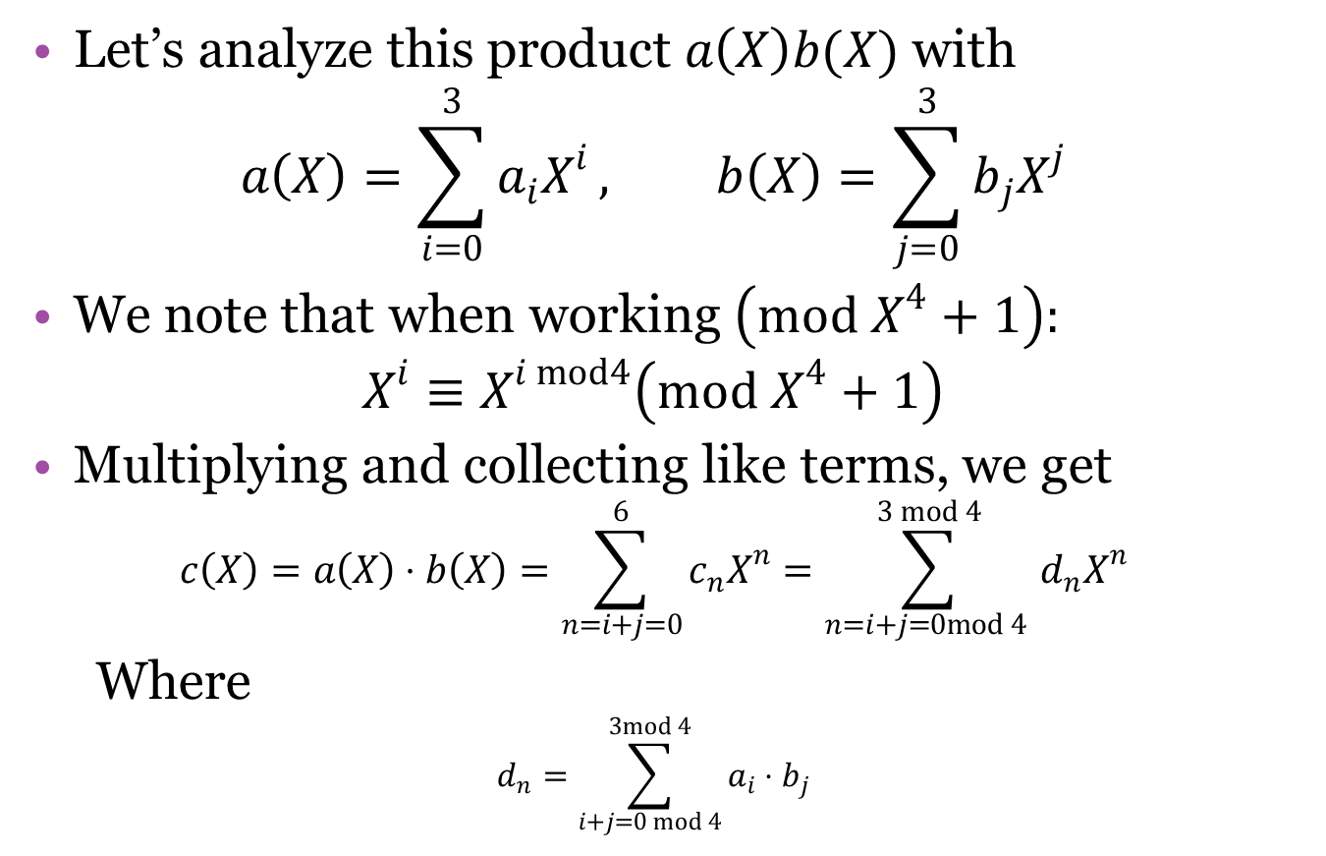
MixColumns (MC)
Let’s analyze this product $a\left(X\right)b(X)$ with
$$a\left(X\right)=\sum_{i=0}^{3}{a_{i}X^{i}}, b\left(X\right)=\sum_{j=0}^{3}{b_{j}X^{j}}$$
We note that when working $\left(mod X^{4}+1\right):$
$$X^{i}≡X^{i mod4}\left(mod X^{4}+1\right)$$
Multiplying and collecting like terms, we get
$$c\left(X\right)=a\left(X\right)⋅b\left(X\right)=\sum_{n=i+j=0}^{6}{c_{n}X^{n}}=\sum_{n=i+j=0mod 4 }^{3 mod 4}{d_{n}X^{n}}$$
Where
$$d_{n}=\sum_{i+j=0 mod 4}^{3mod 4}{a_{i}⋅b_{j}}$$

Slide 29
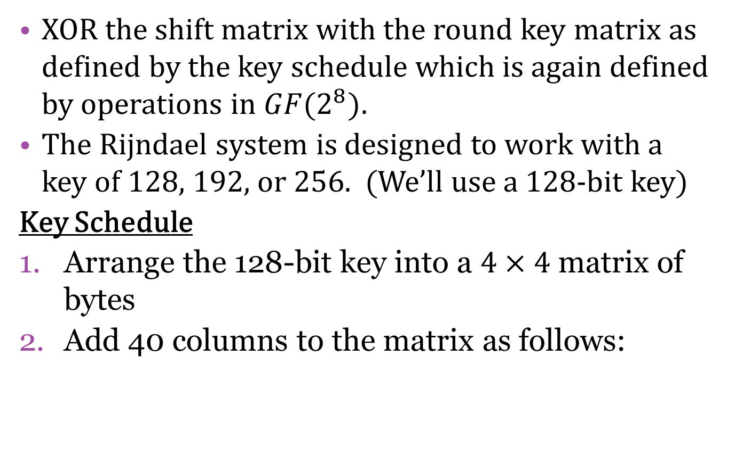
AddRoundKey (ARK)
XOR the shift matrix with the round key matrix as defined by the key schedule which is again defined by operations in $GF(2^{8})$.
The Rijndael system is designed to work with a key of 128, 192, or 256. (We’ll use a 128-bit key)
Key Schedule
Arrange the 128-bit key into a $4×4$ matrix of bytes
Add 40 columns to the matrix as follows:

Slide 30
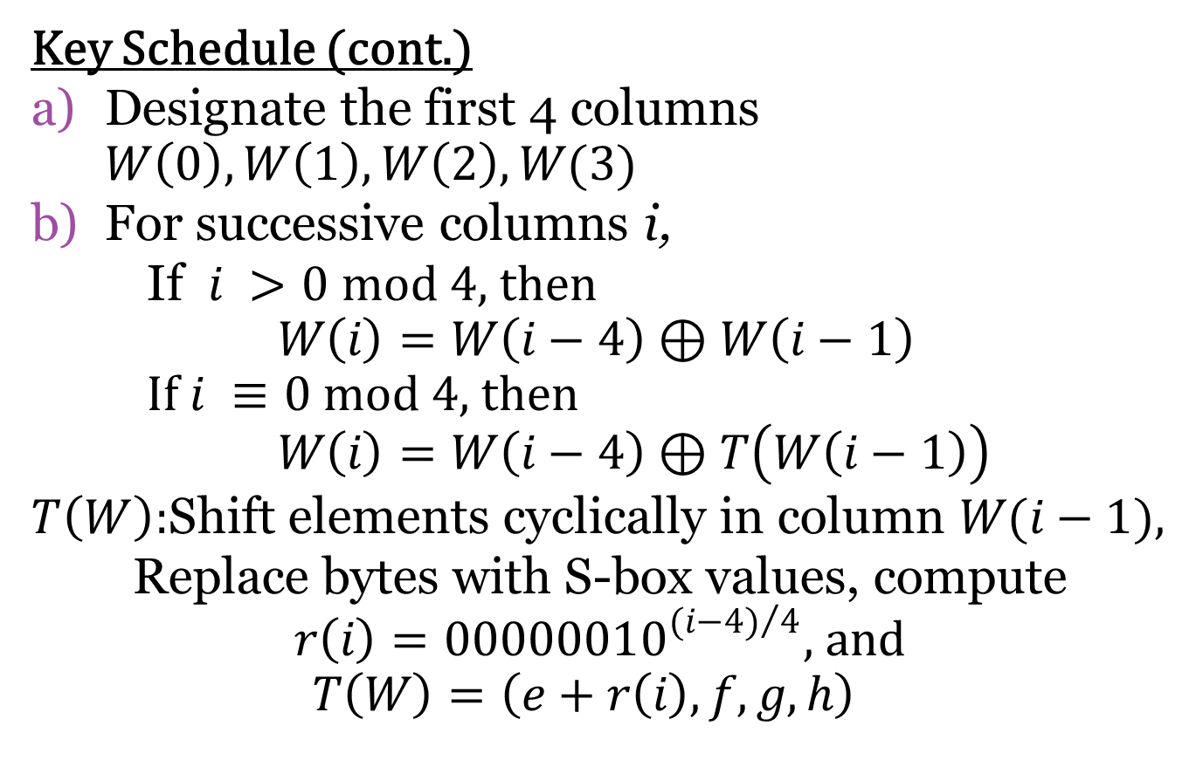
AddRoundKey (ARK)
Key Schedule (cont.)
Designate the first 4 columns $W\left(0\right),W\left(1\right), W\left(2\right), W(3)$
For successive columns i,
If $i >0 mod 4$, then
$W\left(i\right)=W\left(i−4\right)⊕W\left(i−1\right)$
If $i ≡0 mod 4$, then
$W\left(i\right)=W\left(i−4\right)⊕T\left(W\left(i−1\right)\right)$
$T\left(W\right)$:Shift elements cyclically in column $W(i−1)$,
Replace bytes with S-box values, compute
$r\left(i\right)={00000010}^{{(i−4)}/4},$and
$$T\left(W\right)=\left(e+r\left(i\right),f,g,h\right)$$

Slide 31
Encryption/Decryption
Rijndael Encryption Summary
For the 128-bit key, we encryption includes
ARK with the 0th round key,
Nine rounds of BS, SR, MC, and ARK,
using keys 1 to 9, and
Tenth round of BS, SR, and ARK using the 10th key.
Rijndael Decryption Summary
Each encryption layer is invertible! The reverse algorithm is:
ARK with 10th round key,
Nine rounds of IBS, ISR, IMC, IARK using keys 9 to 1
Tenth round of IBS, ISR, and ARK using the 10th key.

Slide 32
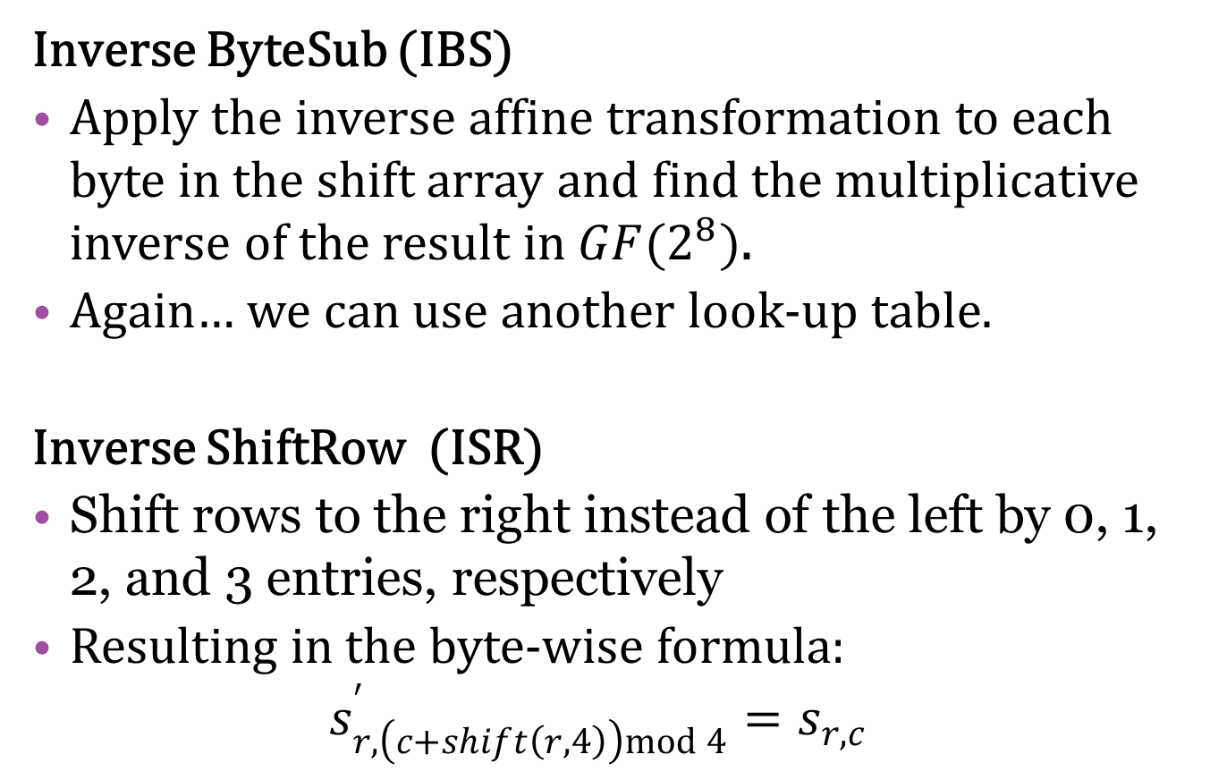
Decryption Layers
Inverse ByteSub (IBS)
Apply the inverse affine transformation to each byte in the shift array and find the multiplicative inverse of the result in $GF(2^{8})$.
Again… we can use another look-up table.
Inverse ShiftRow (ISR)
Shift rows to the right instead of the left by 0, 1, 2, and 3 entries, respectively
Resulting in the byte-wise formula:
$$s_{r,\left(c+shift\left(r,4\right)\right)mod 4}^{′}=s_{r,c}$$

Slide 33
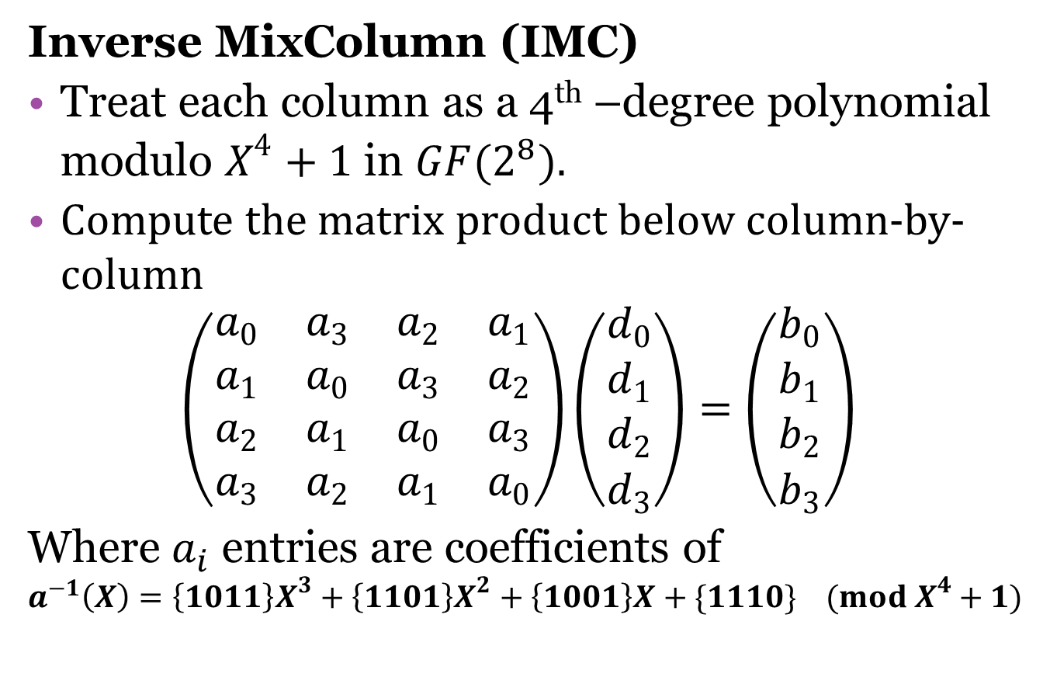
Decryption Layers
Inverse MixColumn (IMC)
Treat each column as a 4th –degree polynomial modulo $X^{4}+1$ in $GF(2^{8})$.
Compute the matrix product below column-by-column
$$\left(\begin{matrix}a_{0} & a_{3} & a_{2} & a_{1} \\ a_{1} & a_{0} & a_{3} & a_{2} \\ a_{2} & a_{1} & a_{0} & a_{3} \\ a_{3} & a_{2} & a_{1} & a_{0}\end{matrix}\right)\left(\begin{matrix}d_{0} \\ d_{1} \\ d_{2} \\ d_{3}\end{matrix}\right)=\left(\begin{matrix}b_{0} \\ b_{1} \\ b_{2} \\ b_{3}\end{matrix}\right)$$
Where $a_{i}$ entries are coefficients of
$$a^{−1}\left(X\right)=\left\{1011\right\}X^{3}+\left\{1101\right\}X^{2}+\left\{1001\right\}X+\{1110\} (mod X^{4}+1)$$

Slide 34
Error Correction Codes
Mistakes happen! When transmitting a cryptographic ciphertext, the corruption of even one bit can make a plaintext message unreadable.
Digital data is susceptible to errors from bit reversal due to “noise”.
Error correction codes can identify a bit or bits that have been altered so they can be returned to their original state.

Slide 35
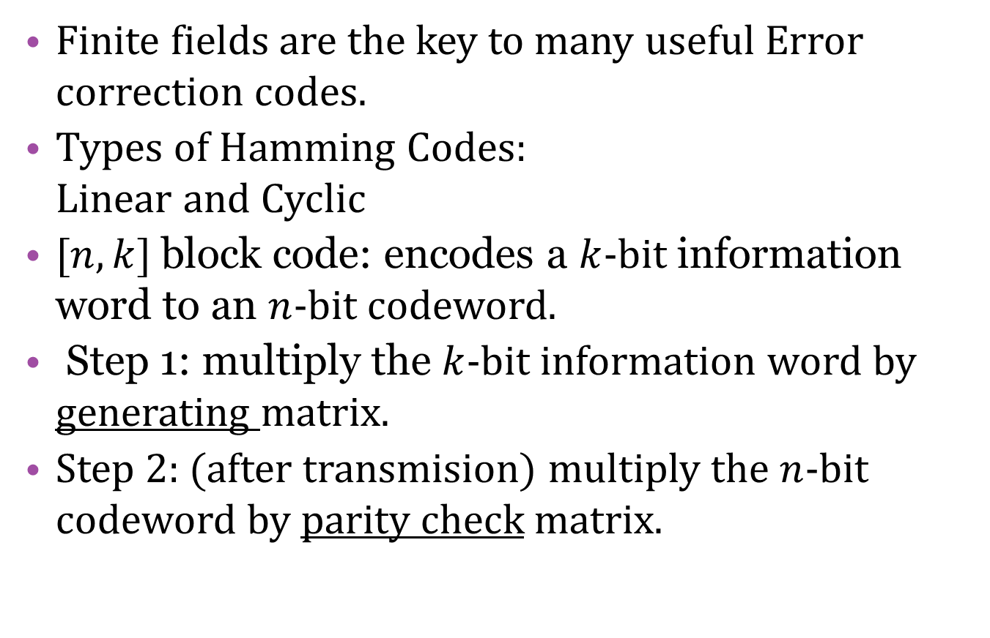
Hamming Codes
Finite fields are the key to many useful Error correction codes.
Types of Hamming Codes:
Linear and Cyclic
$[n,k]$ block code: encodes a $k$-bit information word to an $n$-bit codeword.
Step 1: multiply the $k$-bit information word by generating matrix.
Step 2: (after transmision) multiply the $n$-bit codeword by parity check matrix.

Slide 36
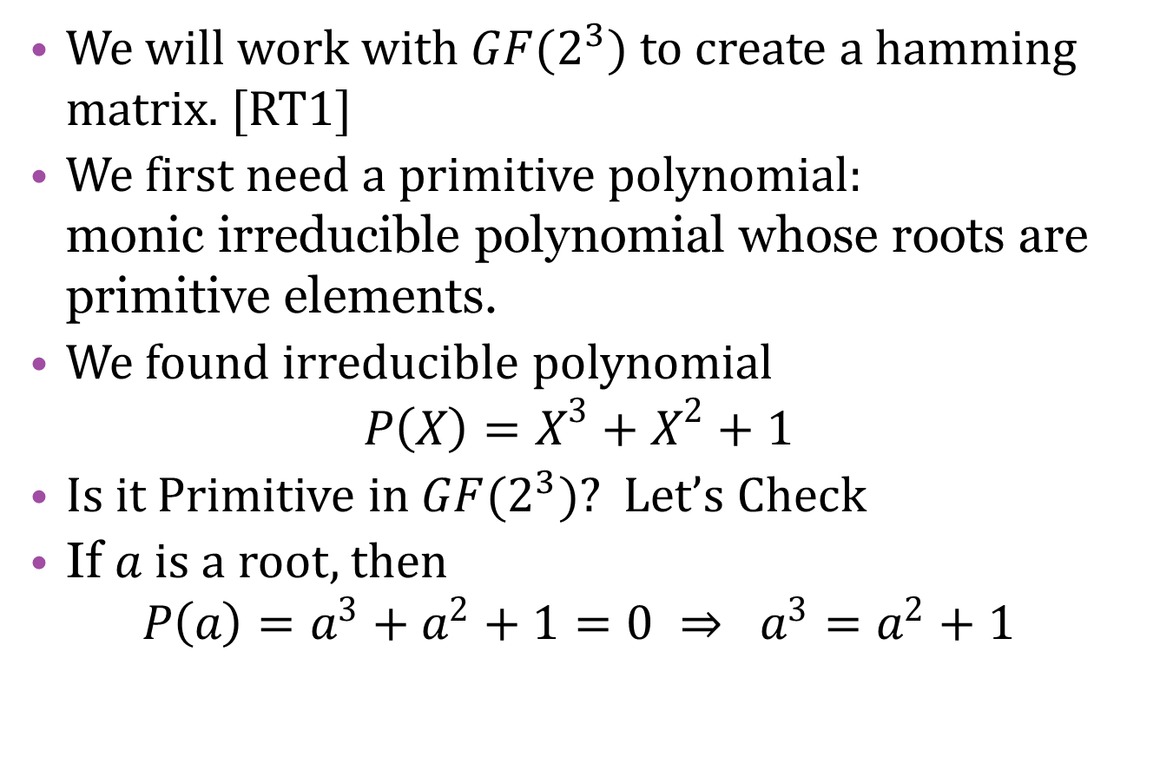
Linear Codes
We will work with $GF(2^{3})$ to create a hamming matrix. [RT1]
We first need a primitive polynomial:
monic irreducible polynomial whose roots are primitive elements.
We found irreducible polynomial
$P\left(X\right)=X^{3}+X^{2}+1$
Is it Primitive in $GF(2^{3})$? Let’s Check
If $a$ is a root, then
$P\left(a\right)=a^{3}+a^{2}+1=0 ⇒ a^{3}=a^{2}+1$

Slide 37
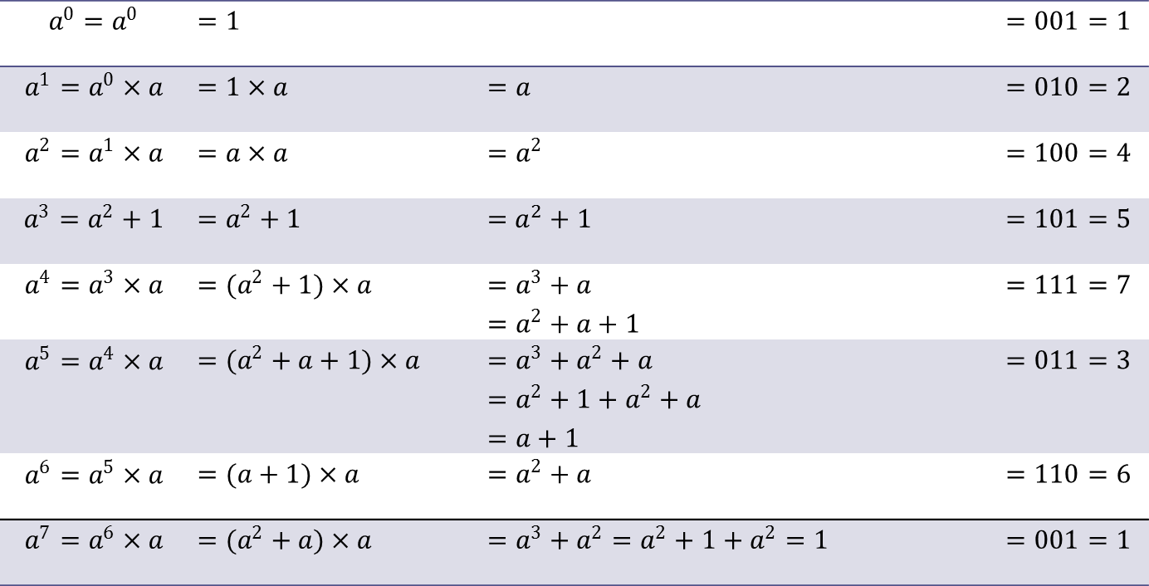
Linear Codes
$$a^{0}=a^{0}$$ | $=1$ |  | $=001=1$
$$a^{1}=a^{0}×a$$ | $=1×a$ | $=a$ | $=010=2$
$$a^{2}=a^{1}×a$$ | $=a×a$ | $=a^{2}$ | $=100=4$
$$a^{3}=a^{2}+1$$ | $=a^{2}+1$ | $=$ $a^{2}+1$ | $=101=5$
$$a^{4}=a^{3}×a$$ | $=(a^{2}+1)×a$ | $=a^{3}+a$ $=a^{2}+a+1$ | $=111=7$
$$a^{5}=a^{4}×a$$ | $=(a^{2}+a+1)×a$ | $=a^{3}+a^{2}+a$ $=a^{2}+1+a^{2}+a$ $=a+1$ | $=011=3$
$$a^{6}=a^{5}×a$$ | $=(a+1)×a$ | $=a^{2}+a$ | $=110=6$
$$a^{7}=a^{6}×a$$ | $=(a^{2}+a)×a$ | $=a^{3}+a^{2}=a^{2}+1+a^{2}=1$ | $=001=1$

Slide 38
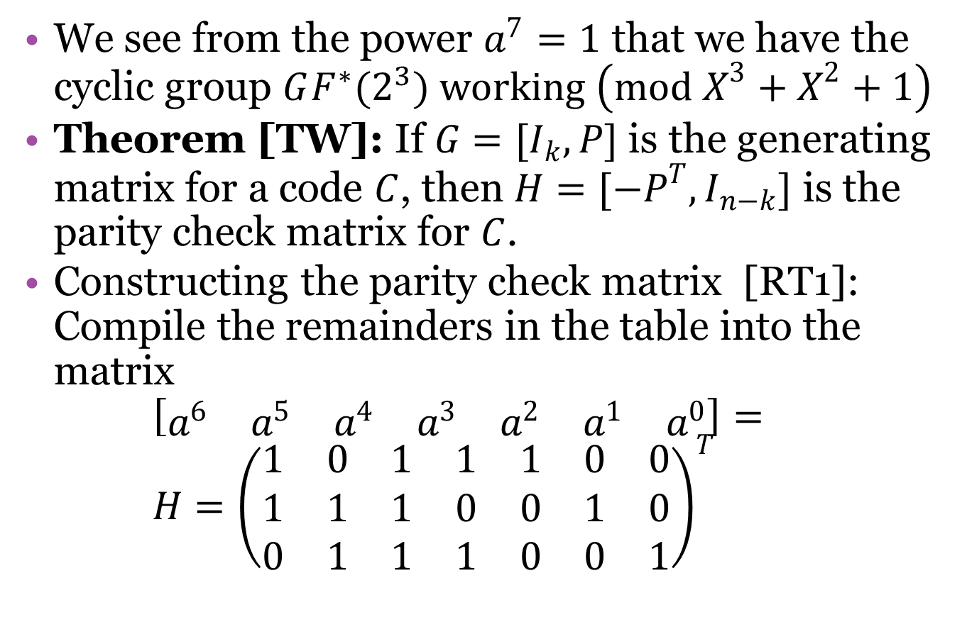
Parity Check Matrix
We see from the power $a^{7}=1$ that we have the cyclic group $GF^{∗}(2^{3})$ working $\left(mod X^{3}+X^{2}+1\right)$
Theorem [TW]: If $G=[I_{k},P]$ is the generating matrix for a code $C$, then $H=[−P^{T},I_{n−k}]$ is the parity check matrix for $C$.
Constructing the parity check matrix [RT1]:
Compile the remainders in the table into the matrix
$\left[\begin{matrix}a^{6} & a^{5} & a^{4} & a^{3} & a^{2} & a^{1} & a^{0}\end{matrix}\right]=$
$H={\left(\begin{matrix}1 & 0 & 1 & 1 & 1 & 0 & 0 \\ 1 & 1 & 1 & 0 & 0 & 1 & 0 \\ 0 & 1 & 1 & 1 & 0 & 0 & 1\end{matrix}\right)}^{T}$

Slide 39
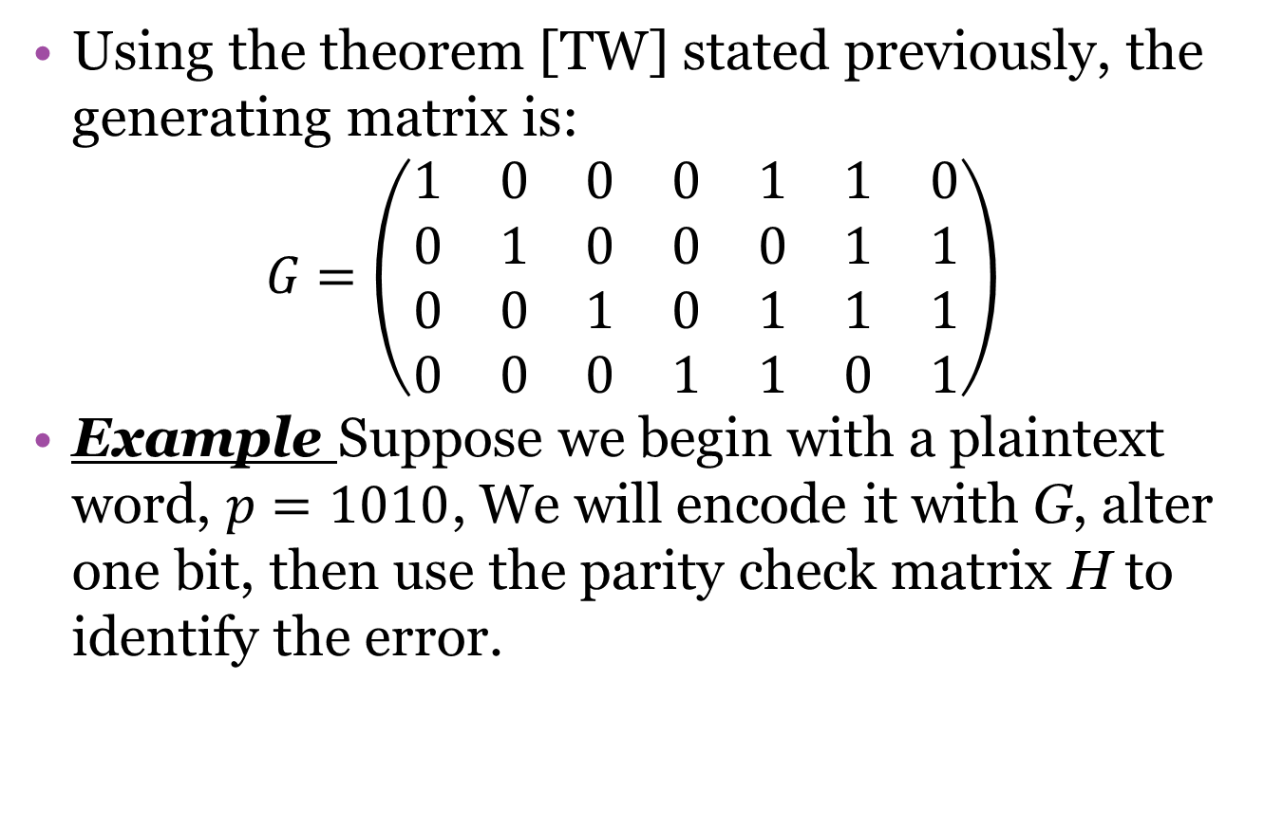
Generating Matrix
Using the theorem [TW] stated previously, the generating matrix is:
$$G=\left(\begin{matrix}1 & 0 & 0 & 0 & 1 & 1 & 0 \\ 0 & 1 & 0 & 0 & 0 & 1 & 1 \\ 0 & 0 & 1 & 0 & 1 & 1 & 1 \\ 0 & 0 & 0 & 1 & 1 & 0 & 1\end{matrix}\right)$$
Example Suppose we begin with a plaintext word, $p=1010$, We will encode it with G, alter one bit, then use the parity check matrix H to identify the error.

Slide 40
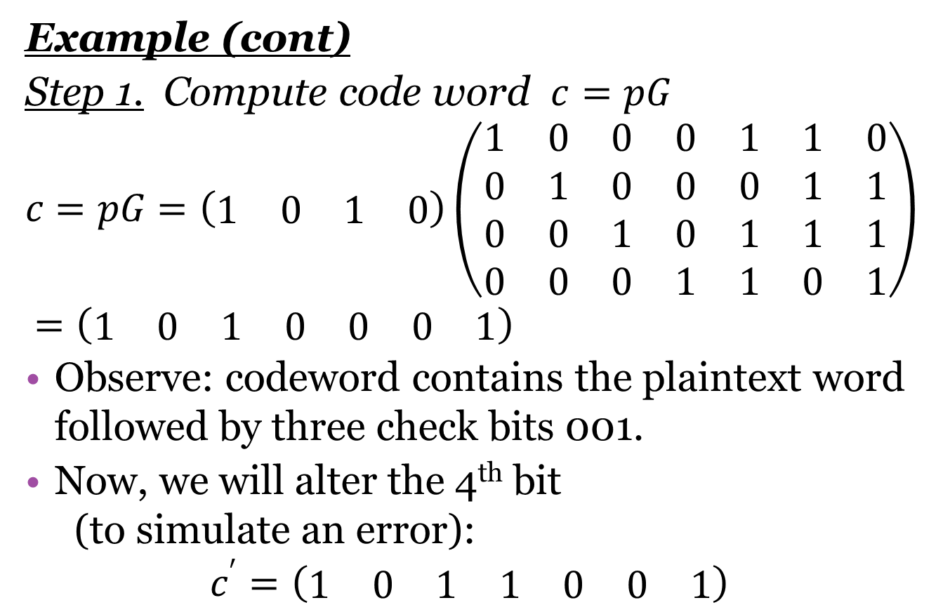
Hamming Example
Example (cont)
Step 1. Compute code word $c=pG$
$$c=pG=\left(\begin{matrix}1 & 0 & 1 & 0\end{matrix}\right)\left(\begin{matrix}1 & 0 & 0 & 0 & 1 & 1 & 0 \\ 0 & 1 & 0 & 0 & 0 & 1 & 1 \\ 0 & 0 & 1 & 0 & 1 & 1 & 1 \\ 0 & 0 & 0 & 1 & 1 & 0 & 1\end{matrix}\right) \\ =\left(\begin{matrix}1 & 0 & 1 & 0 & 0 & 0 & 1\end{matrix}\right)$$
Observe: codeword contains the plaintext word followed by three check bits 001.
Now, we will alter the 4th bit
(to simulate an error):
$$c^{′}=\left(\begin{matrix}1 & 0 & 1 & 1 & 0 & 0 & 1\end{matrix}\right)$$

Slide 41
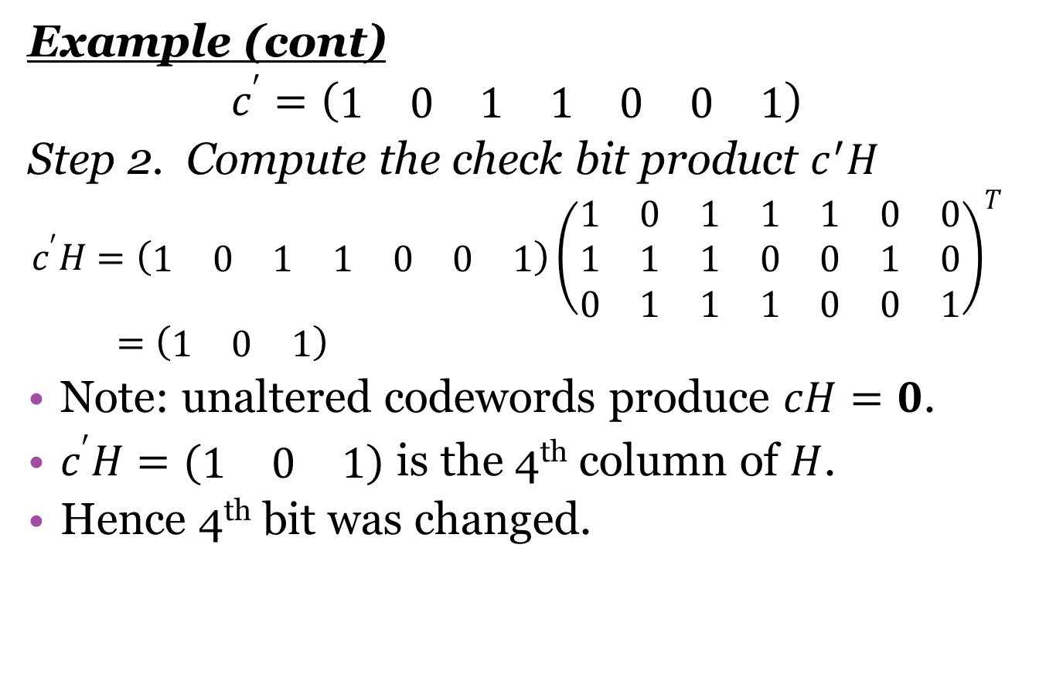
Hamming Example
Example (cont)
$$c^{′}=\left(\begin{matrix}1 & 0 & 1 & 1 & 0 & 0 & 1\end{matrix}\right)$$
Step 2. Compute the check bit product $c^{′}H$
$$c^{′}H=\left(\begin{matrix}1 & 0 & 1 & 1 & 0 & 0 & 1\end{matrix}\right){\left(\begin{matrix}1 & 0 & 1 & 1 & 1 & 0 & 0 \\ 1 & 1 & 1 & 0 & 0 & 1 & 0 \\ 0 & 1 & 1 & 1 & 0 & 0 & 1\end{matrix}\right)}^{T} \\ =\left(\begin{matrix}1 & 0 & 1\end{matrix}\right)$$
Note: unaltered codewords produce $cH=0$.
$c^{′}H=(\begin{matrix}1 & 0 & 1\end{matrix})$ is the 4th column of $H$.
Hence 4th bit was changed.

Slide 42
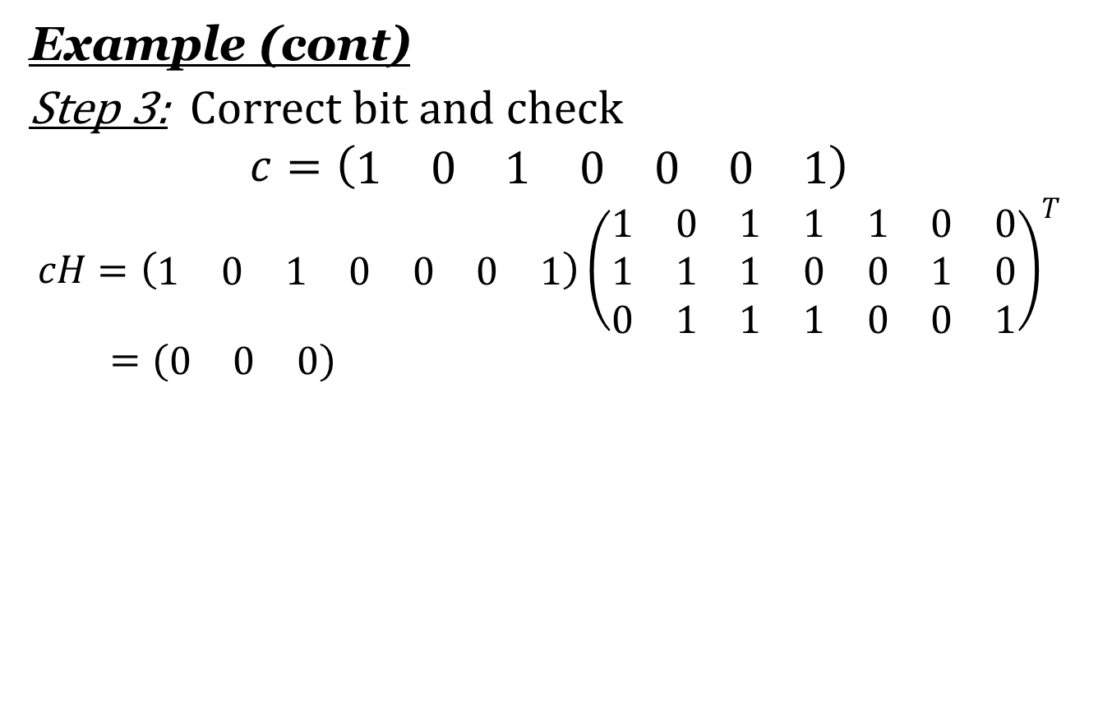
Hamming Example
Example (cont)
Step 3: Correct bit and check
$$c=\left(\begin{matrix}1 & 0 & 1 & 0 & 0 & 0 & 1\end{matrix}\right)$$
$$cH=\left(\begin{matrix}1 & 0 & 1 & 0 & 0 & 0 & 1\end{matrix}\right){\left(\begin{matrix}1 & 0 & 1 & 1 & 1 & 0 & 0 \\ 1 & 1 & 1 & 0 & 0 & 1 & 0 \\ 0 & 1 & 1 & 1 & 0 & 0 & 1\end{matrix}\right)}^{T} \\ =(\begin{matrix}0 & 0 & 0\end{matrix})$$

Slide 43
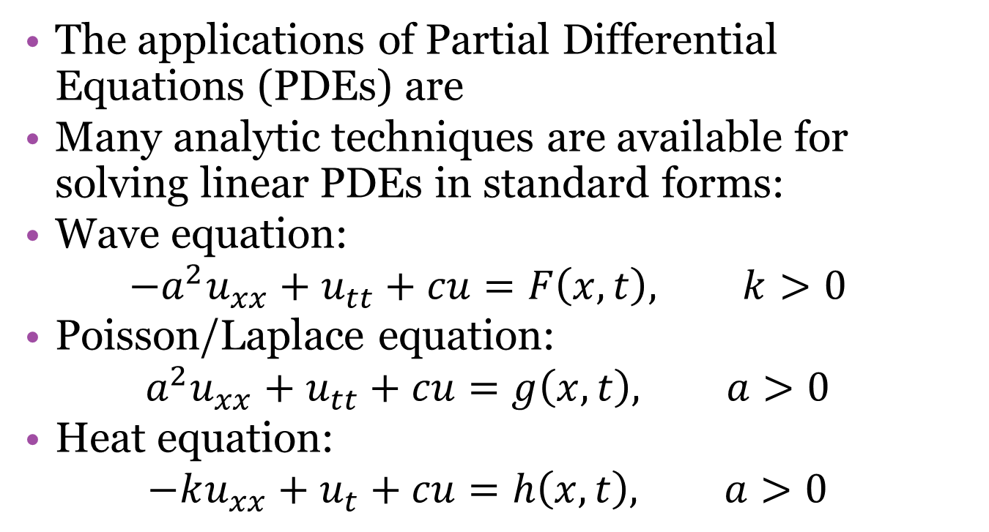
Finite Elements and P.D.E.s
The applications of Partial Differential Equations (PDEs) are
Many analytic techniques are available for solving linear PDEs in standard forms:
Wave equation:
$$−a^{2}u_{xx}+u_{tt}+cu=F\left(x,t\right), k>0$$
Poisson/Laplace equation:
$$a^{2}u_{xx}+u_{tt}+cu=g\left(x,t\right), a>0$$
Heat equation:
$$−ku_{xx}+u_{t}+cu=h\left(x,t\right), a>0$$

Slide 44
Numerical Methods
In many applications, the equations become too complex for known analytical methods.
In this case, we must use numerical methods of approximating solutions to PDEs.
Difference methods-
    approximate derivatives by calculating differences over increasingly small intervals that converge to the analytical solution
Other useful methods:
    Crank-Nicolson method and Rayleigh-Ritz method

Slide 45
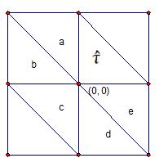
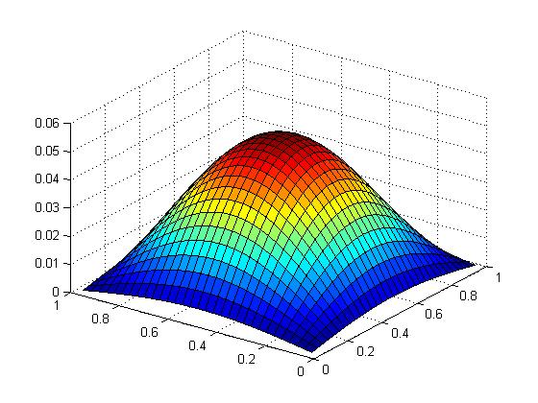
Finite Element Method
A given region is divided into a finite number of geometric sub-regions, called the finite elements.
Use a set of basis functions from a chosen function space to extrapolate the values of the solution for each finite element using initial values and boundary values

Slide 46
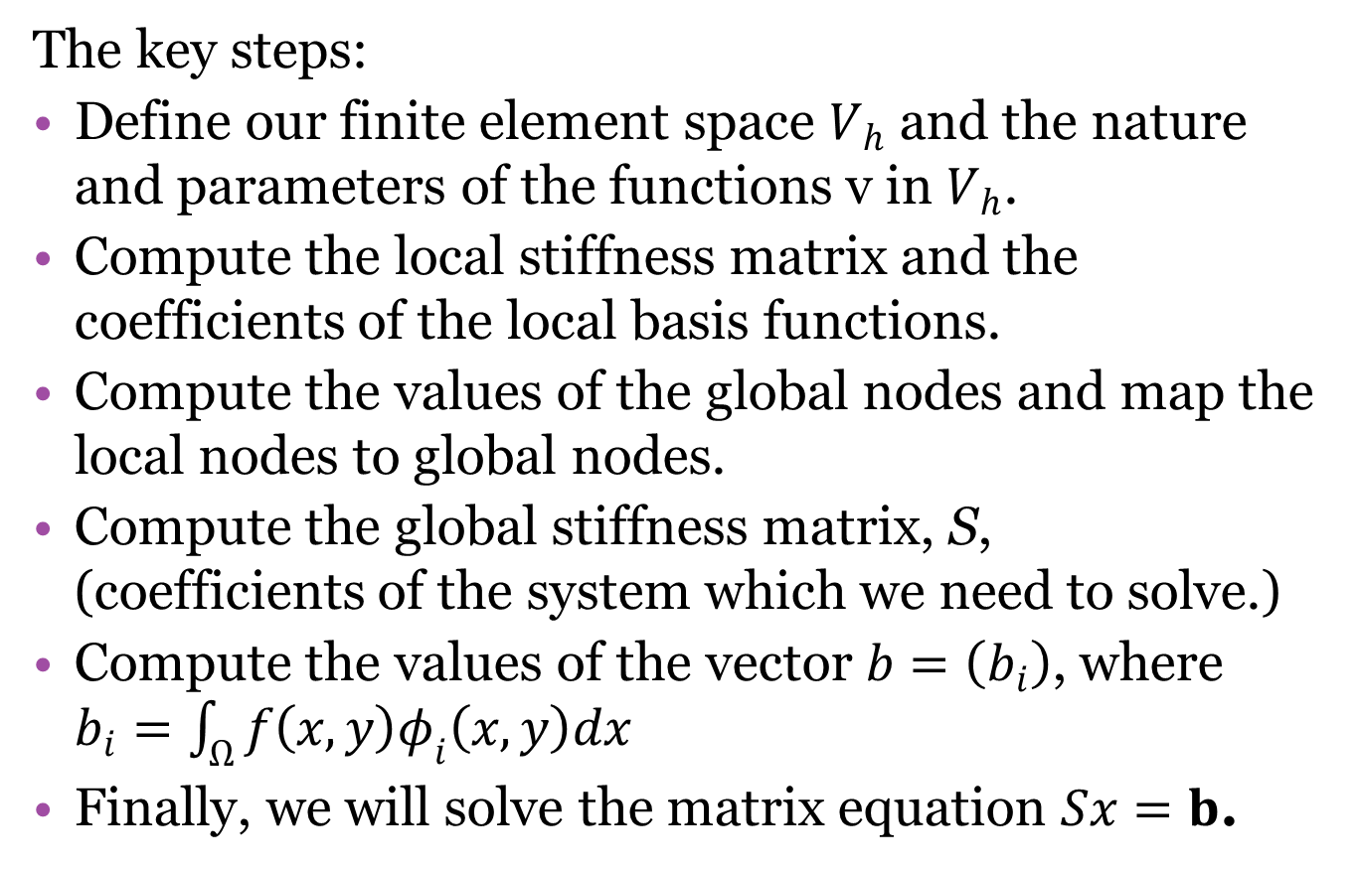
Finite Element Method
The key steps:
Define our finite element space $V_{h}$ and the nature and parameters of the functions v in $V_{h}$.
Compute the local stiffness matrix and the coefficients of the local basis functions.
Compute the values of the global nodes and map the local nodes to global nodes.
Compute the global stiffness matrix, S,
(coefficients of the system which we need to solve.)
Compute the values of the vector $b=\left(b_{i}\right)$, where $b_{i}=\int_{Ω}{f\left(x,y\right)φ_{i}\left(x,y\right)dx}$
Finally, we will solve the matrix equation $Sx=b$.

Slide 47
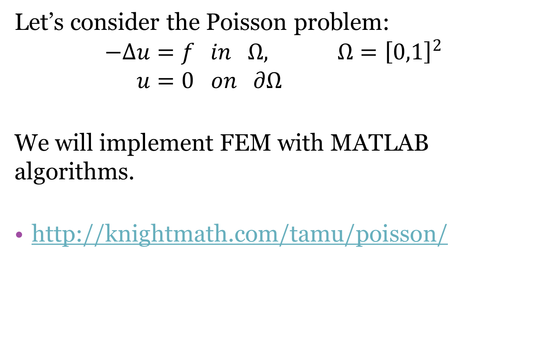
FEM and Poisson’s Equation
Let’s consider the Poisson problem:
$$−Δu=f in Ω, Ω={\left[0,1\right]}^{2} \\ u=0 on ∂Ω$$
We will implement FEM with MATLAB algorithms.
http://knightmath.com/tamu/poisson/

Slide 48
2^{k} Factorial Design
Experiments are an important tool for all areas of science and engineering.
We must carefully consider the design of the experiment.
Often a result is affected by multiple factors.
It is useful to perform a factorial experiment, which is performed at all factor levels.

Slide 49
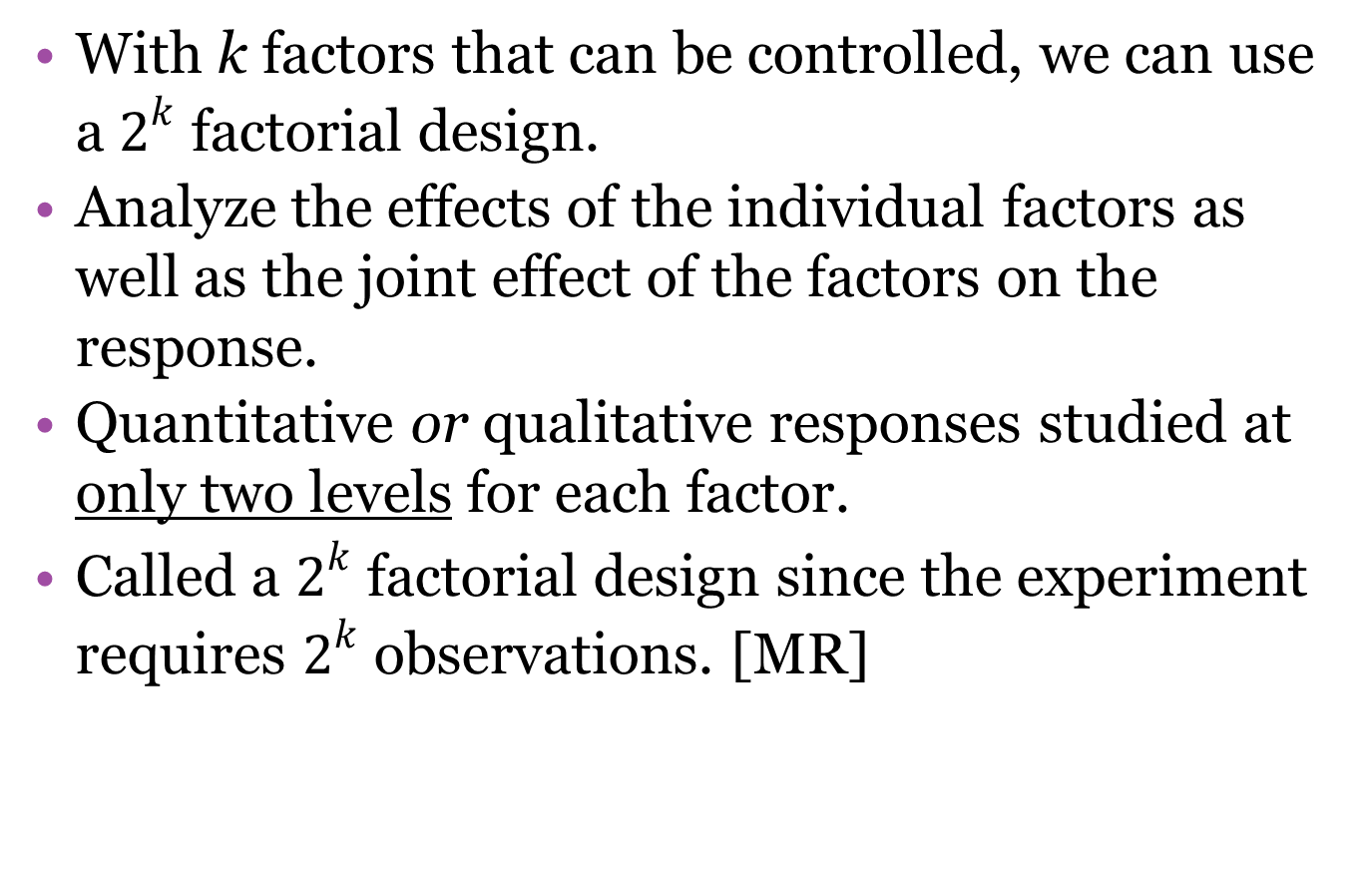

$2^{k}$ Factorial Design
With k factors that can be controlled, we can use a $2^{k}$ factorial design.
Analyze the effects of the individual factors as well as the joint effect of the factors on the response.
Quantitative or qualitative responses studied at only two levels for each factor.
Called a $2^{k}$ factorial design since the experiment requires $2^{k}$ observations. [MR]

Slide 50
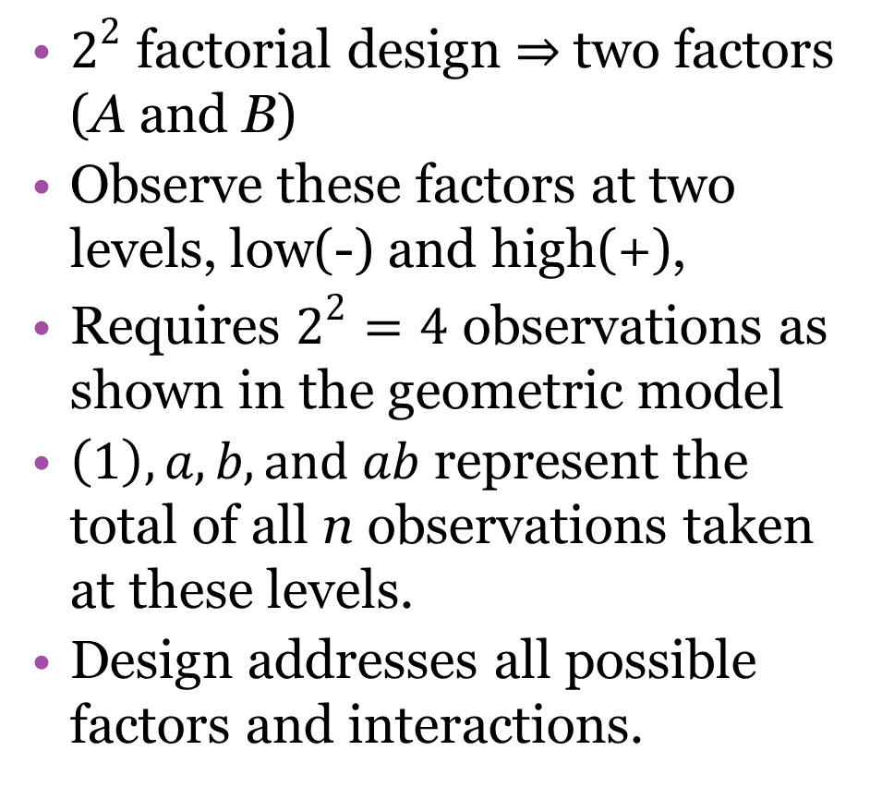
$2^{k}$ Factorial Design
$2^{2}$ factorial design $⇒$two factors
(A and B)
Observe these factors at two levels, low(-) and high(+),
Requires $2^{2}=4$ observations as shown in the geometric model
$\left(1\right), a, b, and ab$ represent the total of all n observations taken at these levels.
Design addresses all possible factors and interactions.
Treat
ment A B
(1) - -
a + -
b - +
ab + +

Slide 51
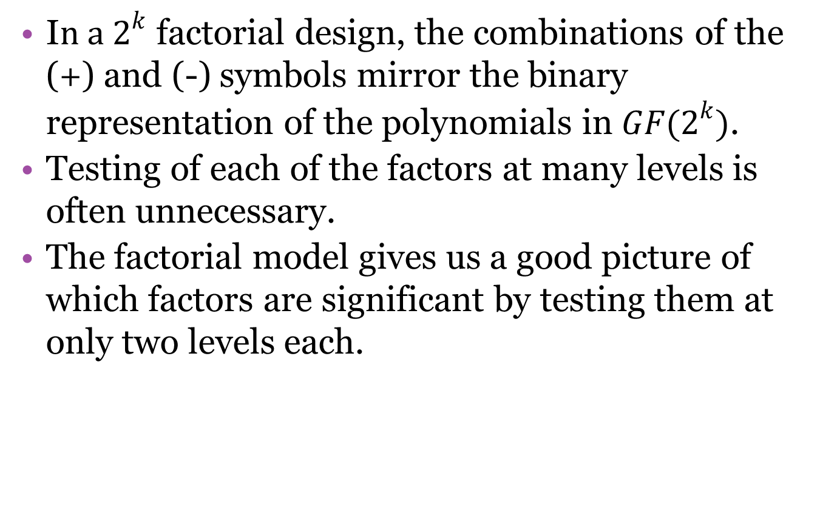
$2^{k}$ Factorial Design
I$n a 2^{k}$ factorial design, the combinations of the (+) and (-) symbols mirror the binary representation of the polynomials in $GF(2^{k})$.
Testing of each of the factors at many levels is often unnecessary.
The factorial model gives us a good picture of which factors are significant by testing them at only two levels each.

Slide 52

Clinical Samples
Example:
An article in Analytica Chimica Acta examined four parameters that affect the sensitivity and detection of the analytical instruments used to measure clinical samples. They optimized the sensor function using EBC samples spiked with acetone, a known clinical biomarker in breath. The following table shows the results for a single replicate of a $2^{4}$ factorial experiment for one of the outputs, the average amplitude of acetone peak over three repetitions.

Slide 53
Clinical Samples
Configuration | A | B | C | D | Yield
1 | + | + | + | + | 0.12
2 | + | + | + | - | 0.1193
3 | + | + | - | + | 0.1196
4 | + | + | - | - | 0.1192
5 | + | - | + | + | 0.1186
6 | + | - | + | - | 0.1188
7 | + | - | - | + | 0.1191
8 | + | - | - | - | 0.1186
9 | - | + | + | + | 0.121
10 | - | + | + | - | 0.1195
11 | - | + | - | + | 0.1196
12 | - | + | - | - | 0.1191
13 | - | - | + | + | 0.1192
14 | - | - | + | - | 0.1194
15 | - | - | - | + | 0.1188
16 | - | - | - | - | 0.1188
A: RF voltage of the DMS Sensor (1200 or 1400V)
B: Nitrogen carrier gas flow rate (250 or 500)
C: Solid phase microextraction filter type (polyacrylate or PDMS-DVB)
D: GC cooling profile
(cryogenic and noncryogenic)

Slide 54

Clinical Samples
Data: A $2^{4}$ factorial experiment on clinical samples
Objective: Factor analysis and interaction of factor using an effects model
Hypotheses: We consider the null hypotheses below with a confidence level of 95%.
Main Effects – $H_{0}:{\left(α\right)}_{i}=0$
2-way Interaction Effects - $H_{0}:{\left(αβ\right)}_{ij}=0$
3-way Interaction Effects – $H_{0}:{\left(αβγ\right)}_{ijk}=0$
(We will ignore 4-way interactions since they are highly unlikely to be significant.)

Slide 55

Clinical Samples
Significant main effects: B, C, and D
(p-value<.05)
Significant two-way interactions:
A*C and B*D.

Slide 56

Clinical Samples
interaction profile plots show interactions of A,C and B,D.

Slide 57

Clinical Samples
To analyze the fit of the effects model, we look at the ANOVA table and see that the p-value for the model fit is .0628 which is too high.

Slide 58

Clinical Samples
Since A is not a main effect, we will remove this factor and recalculate the model. When we do this, we get a p-value of .0150. This is an acceptable value for our goodness of fit.

Slide 59
Conclusion
Many real-life applications of mathematics require continuousness and infinite considerations.
However, considering finite sets can prove quite effective in understanding and controlling results.
In all situations, finite sets must be designed with much care and forethought to produce useful results.
If this is done, we can begin to understand the infinite from our finite perspective.

Slide 60

[TW] Trappe, Wade, and Washington, Lawrence C. Introduction to Cryptography with Code Theory. 2nd Edition. Prentice Hall. 2006.
[MR] Montgomery, Douglas C. and Runger, George C. Applied Statistics and Probability for Engineers. 5th edition. John Wiley and Sons. 2011.
[RT1] Tervo, Richard. Error Control Codes from Galois Fields. Course notes for EE4253 Digital Communications. University of New Brunswick.
http://www.ee.unb.ca/cgi-bin/tervo/galois.pl
[RT2] Tervo, Richard. The Hamming Code Revisited – A Matrix Approach. Course notes for EE4253 Digital Communications. University of New Brunswick.
http://www.ee.unb.ca/tervo/ee4253/hamming2.shtml
[NW] Wagner, Niel R., The Laws of Cryptography; The Finite Field $GF(2^{8})$
http://www.cs.utsa.edu/~wagner/laws/FFM.html
http://www.cs.utsa.edu/~wagner/lawsbookcolor/laws.pdf
[NIST] Specification for the Advanced Encryption Standard (AES). National Institute of Standards and Technology. November 26, 2001.
http://csrc.nist.gov/publications/fips/fips197/fips-197.pdf
[HM] Hansen, Tom and Mullen, G.L. Primitive Polynomials Over Finite Fields. Mathematics of Computation. American Mathematical Society. 1992.
http://www.ams.org/journals/mcom/1992-59-200/S0025-5718-1992-1134730-7/S0025-5718-1992-1134730-7.pdf
[MK] Kyuregyan, Melsik K. Iterated constructions of irreducible polynomials over finite fields with linearly independent roots. Science Direct. 2003.
http://web.mit.edu/minilek/Public/irreducible.pdf

